Slide 1
How the internet works..
RAINBOW OF EDUCATION
PowerPoint Presentations

Slide 2
The Internet was made for scientific (science) and military communications in the United States.
How it started..

Slide 3
Even if a part of the Internet is destroyed, data can go through the other computers in the network.

Slide 4
The istory of the Internet

Slide 5
Early Internet
1971
E-mail

Slide 6
1994 Yahoo
1995 Internet Explorer

Slide 7
Social Networks
2004 (2547) Facebook
2006 (2549) Twitter
2007 (2550) IPhone

Slide 8
Commercial Web
1995 (2538) E-bay
On-line auction.
Customer to customer selling.
1995 (2538) Pay Pal
Doing payments on the Internet safely
1998 (2541) Google

Slide 9
Interactive Web
2000 (2543)Blogger
(opinion sharing)
2001 Wikipedia
(encyclopedia)
2001 IPod
(music exchange)
2001 Picasa
(photo sharing)
2004 Flickr
(photo site)
2005 (2548)You Tube (movie sharing)
2005 Google Maps (maps for navigation/finding directions)

Slide 10
More about the Internet..
Information that’s connected like a web.
Most information is free.
The Internet is also called: ‘The Net’ or being ‘on-line’
You can surf trough the Internet by using connections called:
‘hyperlinks’ ( or links) like:
http://w.w.w.nonformal.edu
You can also find information through a program called a ‘Web Browser’ like:
Netscape
Firefox
Internet Explorer

Slide 11
Surfing on the Internet
Inter-net
Back-
Bone,
a net-
work
of
strong central
servers.
Regional servers
Regional servers
Regional
Servers
Local servers
Local servers
Local servers

Slide 12
Most important parts of the Internet
The World Wide Web (WWW)
E-Mail
News
Internet Relay Chat (IRC)

Slide 13
Sending a file to your friend..
The data you are sending do not travel to your friend’s computer directly but it gets broken up into separate data packets
Because these packets will travel separate routes, some will arrive sooner than others

Slide 14
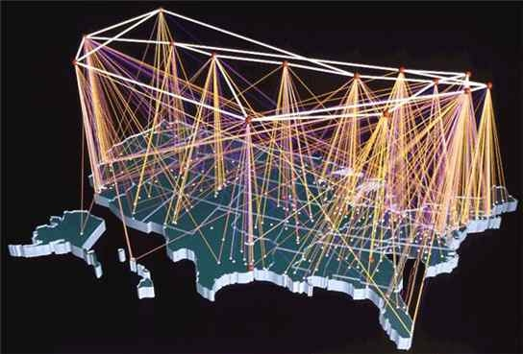
How the internet works… TCP/IP
Every computer on the Internet uses the same protocols (rules and procedures).
This protocol is called TCP/IP (Transmission Control Protocol/Internet Protocol)

Slide 15
Internet: 1. The World Wide Web

Slide 16
Http://
Server: a central computer
HTTP:// is based on the client/server
principle
HTTP allows “computer A (the client) to make a connection to “computer B” the server and makes a request.
The server accepts the connection and sends back a response
Hyper Text Transfer Protocol

Slide 17
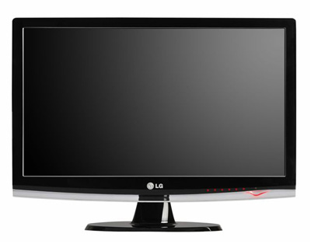
How the Internet works
In order to communicate across the Internet, a computer must have a unique address called an IP (Internet Protocol) address
that is made by the server
Each IP address has 4 parts; each part a number between
0-255.
An IP address might look like this:
205.46.117.104
IP ADDRESS
Connecting to:
205.46.117.104

Slide 18
Domain name
Most Internet hosts or servers have a domain address, which uses words
A domain name identifies the type of institution that owns the computer. An Internet server owned by IBM might have the domain name: ibm.com

Slide 19
Internet Domains
Domain | Type of organization | Example
.com | Business (commercial) | Ibm.com
.edu | Educational | banpapongenglish.edu
.gov | Government | thailand.gov
.mil | Military | navy.mil
.net | Business/commercial | mindspring.net
.org | Other organization (typically nonprofit) | Thailandhealthcare.org

Slide 20
The URL (Uniform Recourse Locater )
The domain name:
edu. = educational.
HTTP://
The computer owner
wants to contact a website
of somebody else.
The owner of the website is non.formal
e.p. It’s the address of the computer
owner.
Also called home page.
http://www.non.formal.ep.edu/conversational-english-course
To find this specific web
page, your browser follows
The URL to a folder
named: conversational-English-course
This site is on the
World Wide Web

Slide 21
Let’s repeat about the URL
HTTP://
Allows computer A to make a connection to computer B
IP address
Every computer has an IP address (205.46.117.93).
Domain name
Type of institution that owns the computer (.com)
Specific page
Finally go to a specific page
Of the web site
WWW
Part of the internet that is called the World Wide Web.
This is the home page.
URL

Slide 22
Hyperlinks
Link to a website
Link to an email address
bjohnson6@gmail.com
John.expatgermany.com
connection that allows you to move between two computer documents or two pages on the Internet

Slide 23
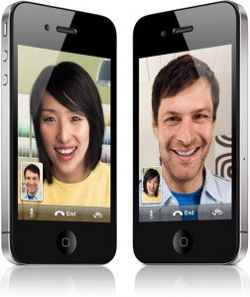
2. Internet Relay Chat
Allows users to communicate in real time by typing text in a special window
You can join chat room discussions.
Famous chat rooms: Windows Live Messenger and the chat room of Facebook.

Slide 24
Advantages (positive things) of e-mail
Convenient
Speed
cheap
Reliable
Global
Generality
Advantages
Convenience
Speed
Inexpensive
Printable
Reliable
Global
Generality
Email Addresses
Basic form of an email address is username@hostname.subdomain.domain
Disadvantages
Misdirection
Interception
Forgery
Overload
Junk
No response

Slide 25
Disadvantages (negative things) of e-mails
Misdirection
Interception
Forgery
Illegal copy
Overload
Junk
(low quality/ no value)
No response
Viruses

Slide 26
3. Newsgroups
Many newsgroups that host discussions on a specific topic.
A newsgroup’s name indicates its users’ special topic of interest, such as:
Alt.food.cake
You can post articles for others to read and respond to

Slide 27
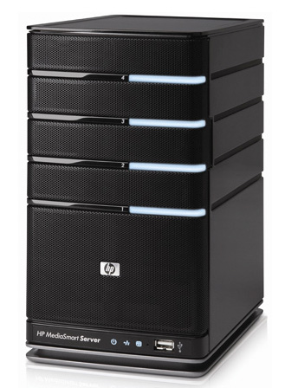
4. Telnet: log in to large mainframe computers
Students can log in to the main computer of their university.
Members of a library can search for favorite books in the library’s main computer.
Hackers can enter these servers when customers have contacts with these servers.
________________________________________________
_______
client
hacker
server

Slide 28
FTP: File Transfer Protocol
FTP is most commonly used to download a file from a server using the Internet or to upload a file to a server (e.g., uploading a Web page file to a server).
Google Web Hosting uploads
Files to the Internet
The Internet
You download files from the Internet to your computer
You Upload files from your computer to the Internet
The Internet
Google Web Hosting downloads you r files from the Internet to it’s server.

Slide 29
The Internet Cloud
On demand self service
Entrance through network
Shared use of resources
Customized services
High degree of elasticity

Slide 30
How to find information on the Web?
To read information on the internet use a web browser like Internet Explorer, Mozilla, Firefox and Opera
Use ‘hyperlinks’ or links.
Use the Website address like
www.it’sme.com
Use a ‘search engine’
like ‘Google’ and Yahoo.

Slide 31
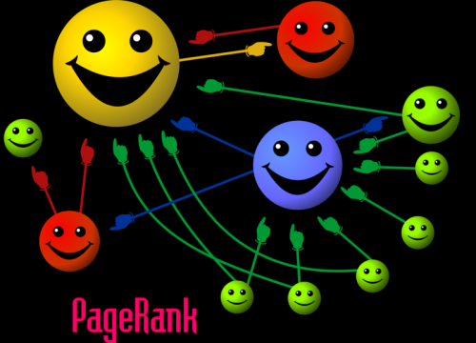
The ranking of web pages..
Google has a machine with a computer program that does the ranking
automatically
The heart of Google’s searching software is “Page Rank”; a system for ranking web pages.
There is some kind of democratic principle. Someone links to a web page, for Google it’s a vote for that page view.
Are there 2 different web pages on the same subject, those with the most votes (links) above the other in the search results will win.
Pages are important also in proportion to how often a surfer would visit them.
Each webpage is given a unit of importance.
A page is important if important pages link to it.

Slide 32
Why you should have a Google account..
Gmail
Maps
Docu
-ments
Calendar
Talk
Blogger
Translate
Web History

Slide 33
Repeating with questions:
No. 3
WWW, e-mail, News,
Telnet, FTP, Internet Relay Chat
The Internet is divided in 6 main components (parts). Which are they?
WWW, e-mail, News, Telnet, FTP, IP address.
WWW, e-mail, News, Telnet, TCP, Internet Relay Chat.
WWW, e-mail, News, Telnet, FTP, Internet Relay Chat,
WWW, e-mail, News, HTTP, FTP, Internet Relay Chat.

Slide 34
Repeating with questions:
Answer no. 3
WWW, e-mail, News,
Telnet, FTP, Internet Relay Chat
There are many ways to search smart on the internet. Quotations search is one of them. What does Quotations search mean?
It is used for searching a word more exactly.
It’s used for the search of 2 words like: snake & head = snake AND head.
It’s used for searching an exact phrase like: “English language class on Sunday”.
It means that search box could not find any results for your search.

Slide 35
Repeating with questions:
No. 4,
TCP/IP
Everything on the Internet depends on computers being able to communicate with each other. For that they need common rules. What is the name of these rules?
Internet Protocol for Computer Transmission.
Transmission Protocol and Internet Rules.
HTTP://Internet Protocol.
Transmission Control Protocol/Internet Protocol.

Slide 36
Repeating with questions..
No. 3:
IP address
In order for computers to connect to each other, they need addresses; these addresses can also be thought of as names.
What is the official name of these addresses?
World Wide Web Address.
E-mail address.
IP address.
Internet Protocol for On-line Addresses (IPOA)

Slide 37
Repeating with questions:
The function of HTTP:// is:
1. Giving rules for a just use of the Internet.
2.Allows the computer of this user to make contact to another computer.
3. Allows the computer of this user to send e-mails to his I-pod.
4. Allows the user of this computer to search in large digital libraries.
No. 2:
Allows the computer
of this user to make
contact to another
computer.

Slide 38
Repeating with questions:
No. 4:
A more detailed
search
What means advanced search?
Advanced search brings you to the first
web-page that Google found for your
search.
It’s an Internet language translator.
A search box that is faster than others.
A more detailed search.

Slide 39
Repeating with questions..
No 3,
Interception, junk, illegal
copying, misdirection, viruses.
Give 5 disadvantages of emails
Viruses, junk, legal copying, interception.
Forgery, viruses, overload, response, junk.
Interception, junk, illegal copying, misdirection, viruses.
Overload, viruses, misdirection, interception, anti -viruses.

Slide 40
Repeating with questions:
No. 1
A connection that allows you to move
between 3 computer documents or two
pages on the internet.
What is a hyperlink?
A connection that allows you to move between two computer documents or two pages on the Internet.
The Google search box.
A connection that allows you to move between two computer parts or two sites on the Internet.
None of these 3.

