Slide 1
Occupations
Rainbow of Education
Worksheets for English

Slide 2
1. firefighter

Slide 3
2. teller

Slide 4
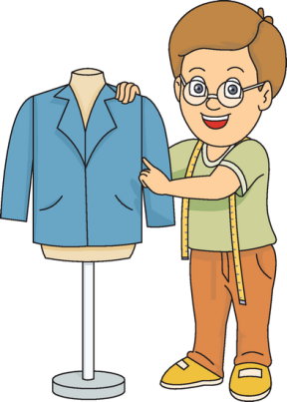
3. tailor

Slide 5
4. cameraman

Slide 6
5. nurse

Slide 7
6. postman

Slide 8
7. shoemaker

Slide 9
8. policeman policewoman

Slide 10
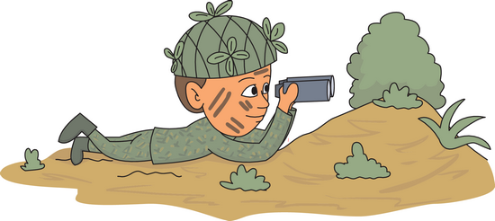
10. soldier

Slide 11
9. journalist

Slide 12
11. technician

Slide 13
12. accountant

Slide 14
Now, let’s exercise

Slide 15
6. postman

Slide 16
7. shoemaker

Slide 17
9. journalist

Slide 18
8. policeman policewoman

Slide 19
2. teller

Slide 20
10. soldier

Slide 21
4. cameraman

Slide 22
3. tailor

Slide 23
5. nurse

Slide 24
11. technician

Slide 25
1. firefighter

Slide 26
12. accountant

