Slide 1
Adjectives
RAINBOW OF EDUCATION
PowerPoint Presentations

Slide 2
ADJECTIVES
The young girl in the red dress left her big red house.
Her little brother followed and said. “Our garden is such a beautiful green space”.
A brown rabbit with big ears hopped into the green garden and scared the little boy. He quickly ran back into the safe house.
The words in orange are adjectives.
Adjectives tell us something about the noun (blue).

Slide 3
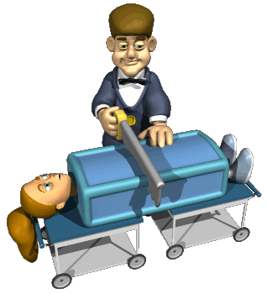
First, we have to know what a noun is.

Slide 4
A noun is a person, a place or a thing.
a person
a thing
a place

Slide 5
Here are some more nouns..
book = thing
nurse = person
cat = thing
queen = person
umbrella = thing
temple = place
A noun is a
person,
place or a thing.

Slide 6
Adjectives describe the noun. This means adjectives tell us more about a person, a place or a thing.

Slide 7
Age
First find the noun.
He is already an old man.
The girl has a very young dog.
A puppy is a young dog.
Then find the word(s) that tells us about the age of this dog.
This is a young
cheese.

Slide 8
Adjectives tell us about color
First find the noun.
This is a red shoe.
This is a yellow
car.
This lady is wearing a blue dress.
Then find the adjective that tells us about the
color of the shoe.

Slide 9
Adjectives give nationality or origin
I am playing on my French horn.
This is the German flag.
I live in a traditional (age) Thai house.
First find the noun.
Then find the word(s) that tells us more about the nationality or origin of the horn.
Notes:
Th

Slide 10
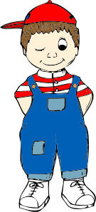
Adjectives tell us something about size and measurement
First find the noun.
Jenna is a tall lady.
Then find the word that tells something about size and measurement.
Stewart is a small boy.
‘Dances with wolves’ is
a long movie.

Slide 11
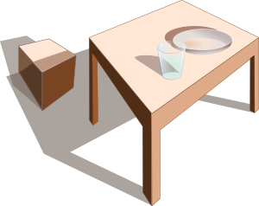
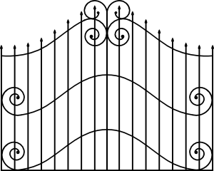
Adjectives tell us also about qualities (characteristics) of things.
The knife is sharp.
Our house has an
iron gate.
A wooden table.
Table is the noun.
‘Then find the word(s) that tells us more about a quality of the table.

Slide 12
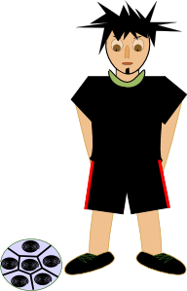
Adjectives describe feelings or qualities
First find the noun.
He is a lonely man.
He is a good football player.
She is a lovely girl.
Then find the word(s) that tells more about the feelings or qualities of the man.

Slide 13
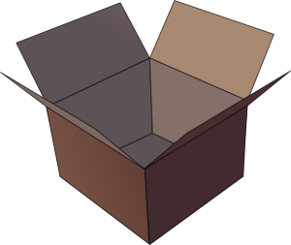
Adjectives tell us also about shape
First find the noun.
This computer has a round button.
A triangular plate.
A rectangular box.
Then find the word that tells us about the shape of the button.

Slide 14
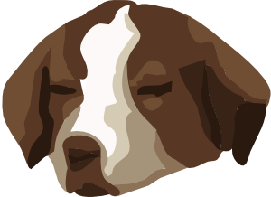
Finally, adjectives express a judgment or value
Grammar is fun !
First find the noun.
A bored dog.
Then find the adjective that gives judgment or value of grammar.

Slide 15
You can make the meaning of an adjective stronger..

Slide 16
To make the meaning of an adjective stronger, use very or really.
This tiger is very
dangerous.
This is a
really beautiful
ring.

Slide 17
Positions of adjectives in a sentence..

Slide 18
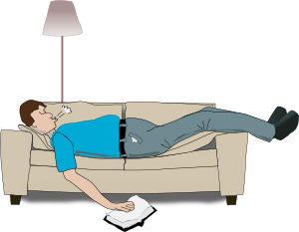
In a sentence the adjective comes..
Usually before a noun:
After verbs like:
‘to be’, ‘to seem’, ‘to look’:
The cat is fat.
He looks tired.
She seems to be ill.
A fat cat

Slide 19
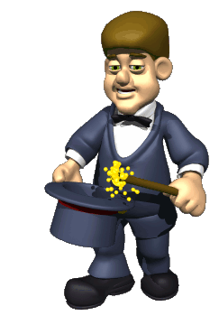
The form of the adjective does not change when the number changes..

Slide 20
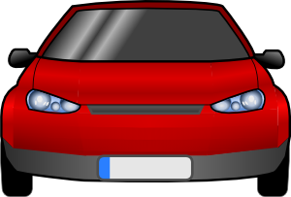
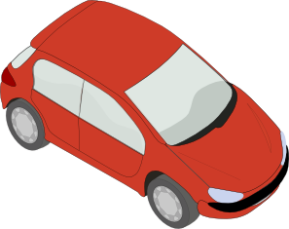
One red car
Three red cars

Slide 21
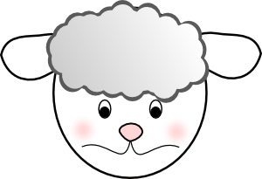
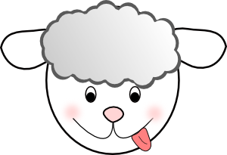
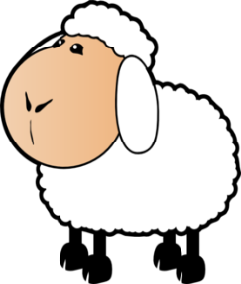
one white sheep
three white sheep
Four white sheep

