Slide 1
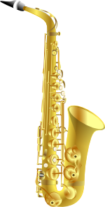
Adverbs
RAINBOW OF EDUCATION
PowerPoint Presentations

Slide 2
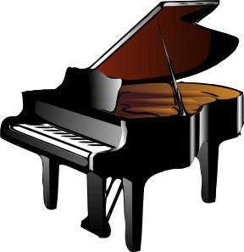
There are many different
kinds of adverbs like..
Adverbs of manner
‘how’ you do something
Adverbs of frequency
‘how often’ you do something
Adverbs of reason ‘Why’ something is done
Adverbs of place
‘where’ you do something
Adverbs of degree
‘to what degree’ you do something
Adverbs of time
‘when’ you do something

Slide 3
Adverbs of manner: How?

Slide 4
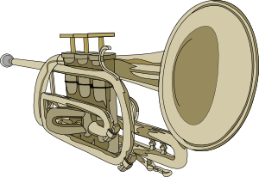
An adverb is a verb that describes an action verb.
It describes how an action is done.
Example: John quickly read the book.
How did John read? : ‘quickly’
‘Quickly’ is an adverb of manner.

Slide 5
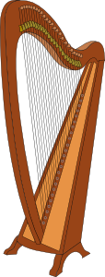
How are adverbs of manner formed? 1. add –ly to most adjectives.
Adjective
Adverb
bad
shy
normal
surprising
quiet
careful
badly
shyly
normally
surprisingly
quietly
carefully

Slide 6
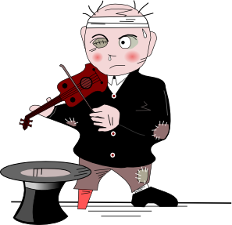
Now, it’s your turn..
First find the action verb and then
look ‘how’ the action is done.
1. Vincent is quietly singing the French song he learnt yesterday.
2. John is smiling happily at his friend.
3. Lionel is sitting quietly at his desk.
4. Stewart is trying hard to find a word in his dictionary.
5. Yara is speaking clearly to her friend.
6. Jasmin is trying desperately to fix the air-conditioner.
7. Steve is laughing loudly at the joke.
8. Thanya is looking innocently at the teacher.

Slide 7
Let’s practice this..
carefully
faster
loudest
quickest
quietly
gently
perfectly
1. Karleigh carefully cuts her sandwich in half.
2. Joey can swim faster than Collin.
3. Deirdre sang the loudest.
4. Who runs the quickest?
5. Please speak quietly when you are
in the library.
6. Place the glass on the table gently.
7. Joey spelled all the words on his spelling
list perfectly.

Slide 8
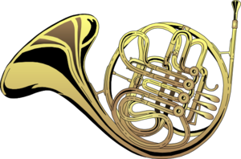
2 When the adjective ends in ‘ic’ the syllable ‘al’ is usually added before the –ly ending.
Adjective:
Adverb of manner:
dramatic
scientific
specific
basic
artistic
dramatically
scientifically
specifically
basically
artistically

Slide 9
The sentence position of most adverbs of manner is at the end of a sentence:
She speaks Italian beautifully.
He works patiently.
You must drive your car carefully.
Eat quietly.
However, we can change the position of adverbs of manner according to what we want to emphasize. Than we can put the adverb before or after a verb:
She carefully put it on the shelf.
She put it carefully on the shelf.

Slide 10
Adverbs of time

Slide 11
‘When’ means: ‘at that time’.
“ When I was 21, I started to work in a beauty salon in Bejing”.
“After I had worked in the salon for three years, I was able to buy it from the owner”.
‘Until’ means: ‘up to that time’.
“I didn’t have any interest in owning a salon of my own until Mary offered to sell hers’’.
‘Since’ means ‘from that time in the past until the present’.
“I have a job since I was 15 years old.”
‘While’ means ‘a continuous action’.
“While I was cutting Susan’s hair, she was telling me all about her life”.
‘During’ describes and event.
“I couldn’t concentrate on my studies during high school“.
‘For’: means ‘an amount of time’. “I have had this salon for 3 years”.

Slide 12
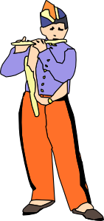
Adverbs of place

Slide 13
Adverbs of place answer the question ‘where’ something is done.
Examples:
Adverb of place:
The boys are playing upstairs.
We’re going to New York City on our school trip.
It’s very sunny but cold outside.
More adverbs of place:
Here, there, inside, around, through, beneath, above, abroad, anywhere, behind, below, under, nearby.
upstairs
New York City
outside

