Slide 1
Introducing your Family Members
RAINBOW OF EDUCATION
PowerPoint Presentations

Slide 2
Good morning everybody, may I introduce my I introduce to you?
His name is Danh.
He is 68 years old.
He comes from Hanoi.
He is retired.
His hobby is music.
Her name is Chau.
She is 65 years old.
She comes from Hanoi.
She is retired.
Her hobby is cooking.
YOU
Its name is Cuc.
It is 8 months old.
It comes from Saigon.
It is a puppy.
It likes to eat chicken .
Her name is Bich.
She is 44 years old.
She comes from Saigon.
She is a house wife.
Her hobby is sewing.
His name is Chi.
He is 46 years old.
He comes from Bangkok.
He is a technician.
His hobby is surfing.
Her name is Bian.
She is 16 years old.
She comes from Saigon.
She is a student.
Her hobby is playing badminton .
His name is Binh.
He is 19 years old.
He comes from Saigon.
He is a policeman.
His hobby is racing .

Slide 3
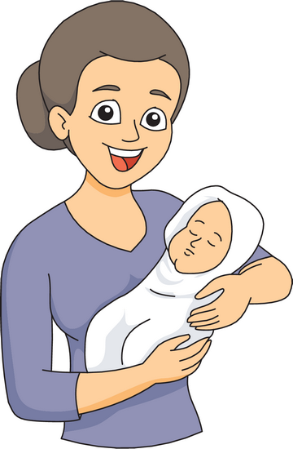
Good morning everybody, may I introduce my mother to you?
name is Nutchanan.
is 41 years old.
is a waitress.
telephone number is 085-698 76 90.
weight is 61 kilograms.
comes from Tak province.
Her
She
She
Her
Her
She

Slide 4
Good morning everybody, may I introduce my sister to you?
name is Vatsana.
is 16 years old.
is a student.
hair is black.
hobby is playing table tennis.
comes from Vientiane.
Her
She
She
Her
Her
She

Slide 5
Good evening everybody, may I introduce my aunt to you?
name is Mary.
comes from the United States.
was born in New York.
nickname is Sissy.
mother comes from Washington.
is a nurse.
Her
She
She
Her
Her
She

Slide 6
Good evening everybody, may I introduce my uncle to you?
name is Michael.
comes from Canada.
was born in Germany.
hobby is racing.
has 2 brothers and 5 sisters.
and his brother John are twins.
His
He
He
His
He
He

Slide 7
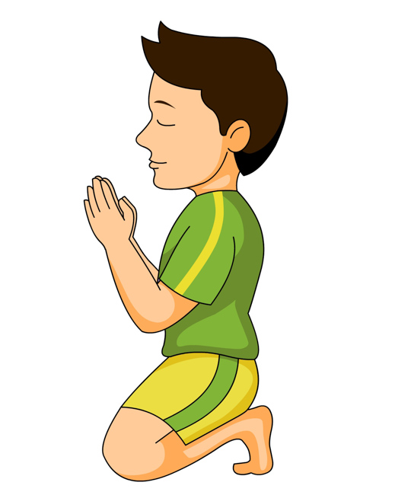
Good evening everybody, may I introduce my nephew to you?
comes from Malaysia .
name is Jim.
likes to pray.
is my nephew.
loves the lord Buddha very much.
sister and he like hiking in the mountains..
He
His
He
He
He
His

Slide 8
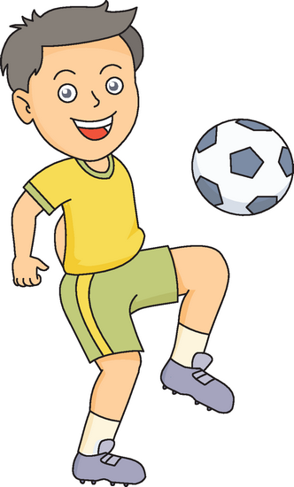
Good evening everybody, may I introduce my cousin to you?
name is Wayne .
is a professional football player.
is very famous.
plays for Manchester United.
parents like karaoke.
doesn’t like karaoke.
His
He
He
He
His
He

Slide 9
Good afternoon everybody, may I introduce my hamster to you?
name is Toedeloo .
weighs 300 gram.
is a male hamster.
is a very kind animal.
cage is under my bed.
likes to sleep.
Its
It
It
It
Its
It

Slide 10
May I introduce my best friend to you?
my
This is___ sister’s best friend.
___ is called Sammy but ____ real name is
Dee.
Next year ___ will visit The United States, his favourite country after Thailand where ____
was born.
___ is a medical student because ____
wants to help people who are sick.
He
his
he
he
He
he

Slide 11
Good…, ……………best friend………..?
name is Nong.
is 24 years old.
is a movie star.
I sometimes go to the temple with .
Her
She
She
her

Slide 12
Good …. May ………….niece…?
name is Maria.
is 16 years old.
is a University student.
is always worried that dog will walk away.
Her
She
She
She
her

Slide 13
Good…. May………father-in-law…?
___ name is Willy.
___ is 57 years old.
___ is a mechanic.
____wife’s name is Cha Cha.
____ met her 30 years ago.
____ is a kind woman.
His
He
He
His
He
She

