Slide 1
Rainbow of Education
Premium Worksheets for English
Food:
basic foods,
vegetables,
fruits

Slide 2
1. Basic international food

Slide 3

noodles

Slide 4
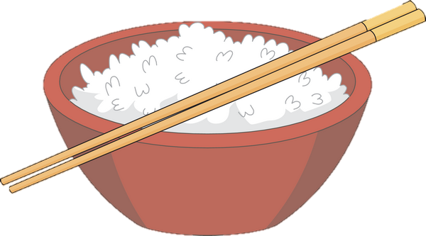
rice

Slide 5
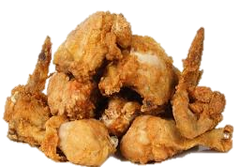
chicken

Slide 6
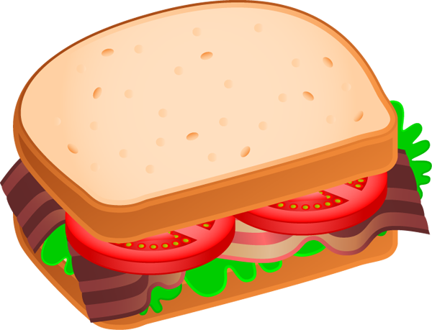
sandwich

Slide 7
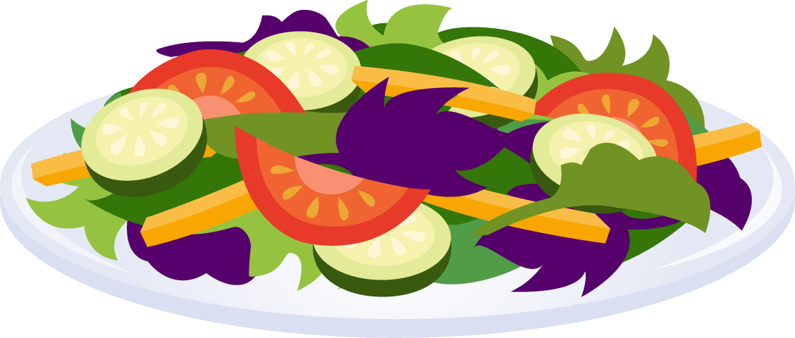
salad

Slide 8

fish

Slide 9
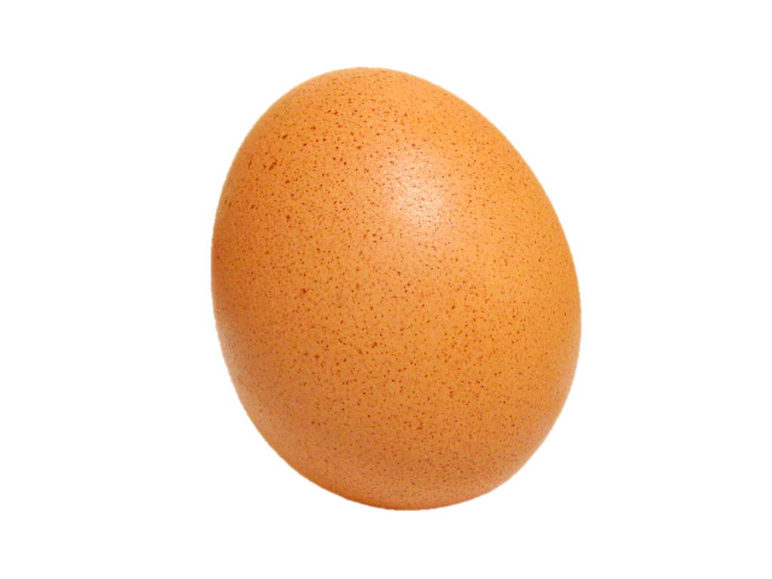
egg

Slide 10

soup

Slide 11


porc

Slide 12
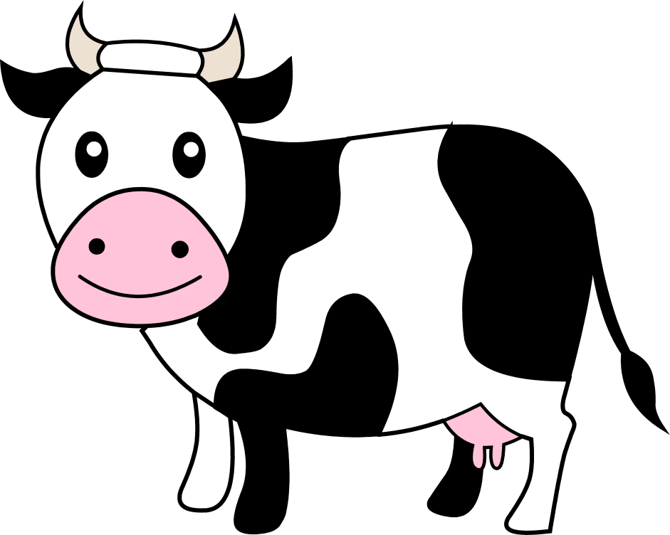

beef

Slide 13
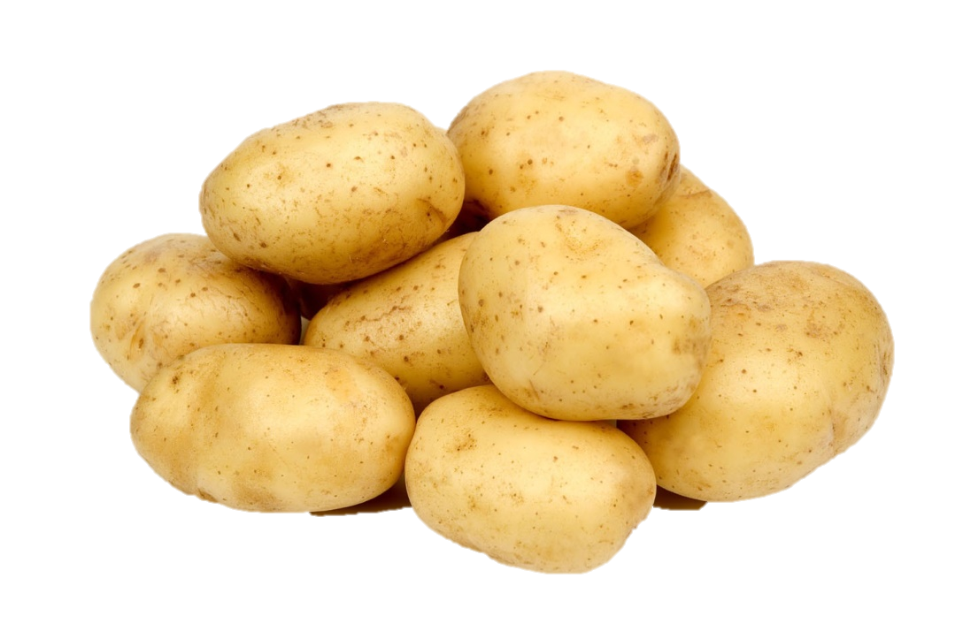
potato

Slide 14
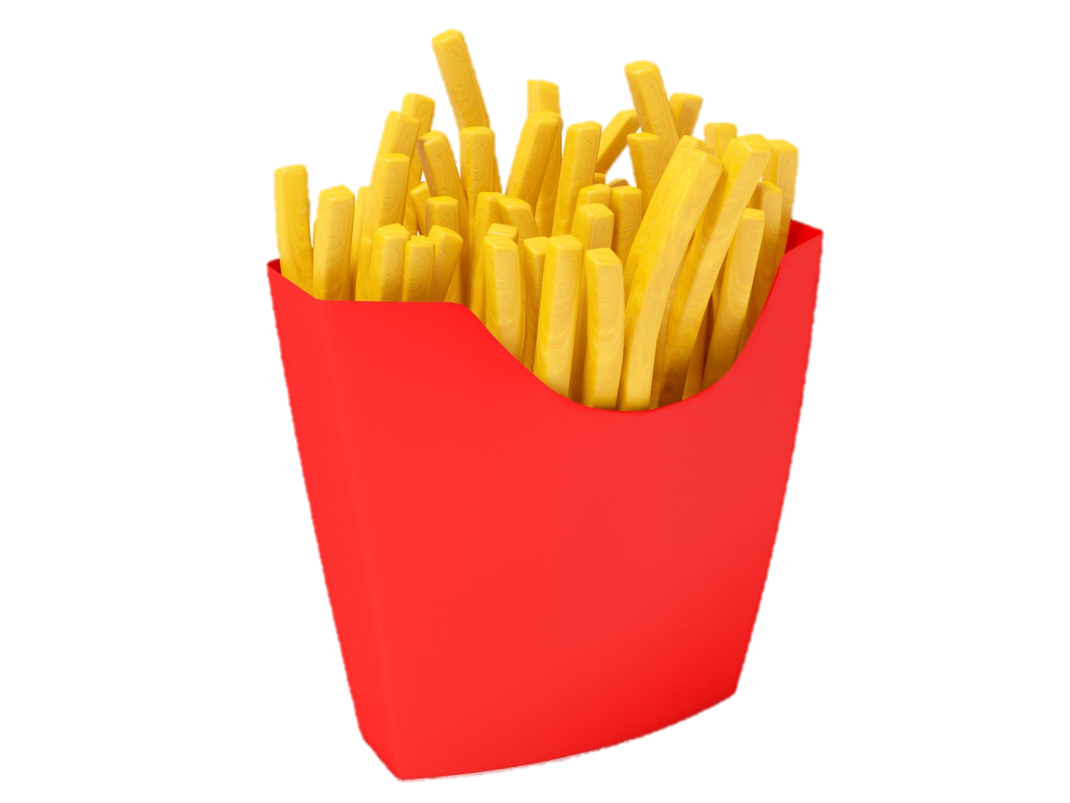
French fries

Slide 15
NOW, LET’S EXERCISE

Slide 16
rice

Slide 17
noodles

Slide 18
chicken

Slide 19
sandwich

Slide 20
salad

Slide 21
pork

Slide 22
fish

Slide 23
egg

Slide 24
soup

Slide 25
beef

Slide 26
French fries

Slide 27
potato

Slide 28

fruits

Slide 29

apple

Slide 30

grapes

Slide 31
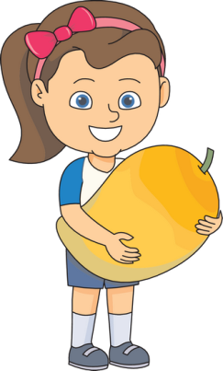
mango

Slide 32

watermelon

Slide 33

pear

Slide 34

banana

Slide 35
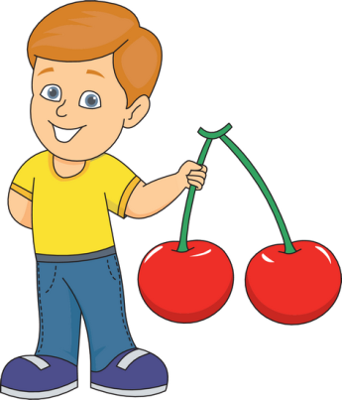
cherry (cherries)

Slide 36
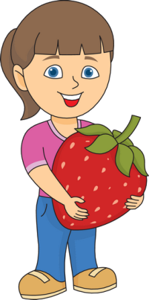
strawberry (strawberries)

Slide 37
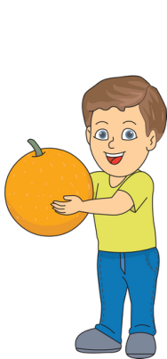
orange

Slide 38
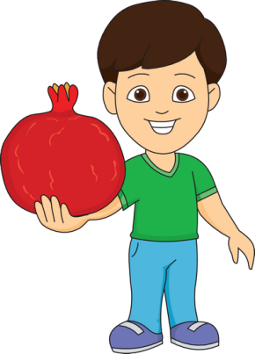
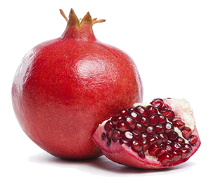
pomegranate

Slide 39
NOW, LET’S EXERCISE

Slide 40
mango

Slide 41
orange

Slide 42
pomegranate

Slide 43
strawberry

Slide 44
cherry (cherries)

Slide 45
banana

Slide 46
pear

Slide 47
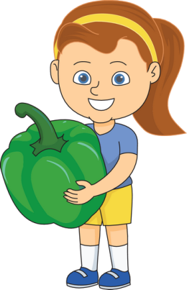
paprika

Slide 48
watermelon

Slide 49
grapes

Slide 50
apple

Slide 51
Vegetables

Slide 52

tomato

Slide 53
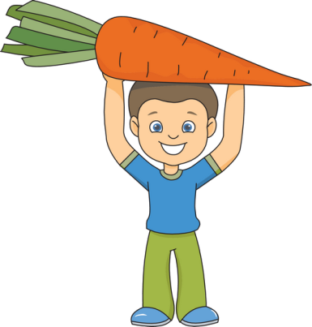
carrot

Slide 54
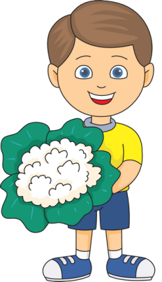
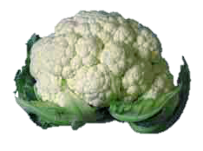
cauliflower

Slide 55
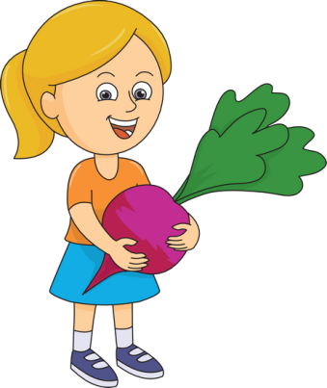
beetroot

Slide 56

pumpkin

Slide 57

eggplant

Slide 58
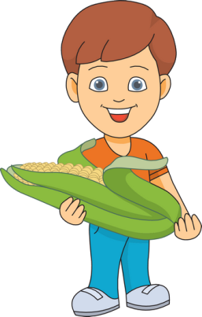
maize

Slide 59
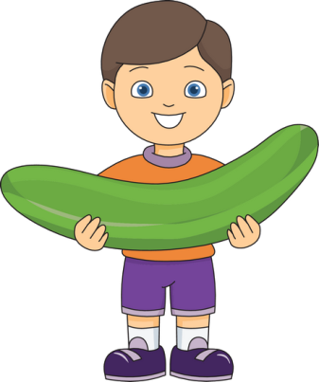
cucumber

Slide 60
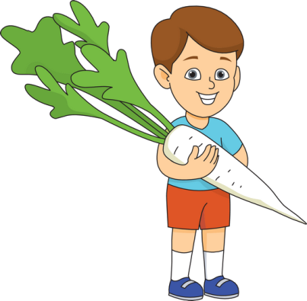
radish

Slide 61
NOW, LET’S EXERCISE

Slide 62
tomato

Slide 63
pumpkin

Slide 64
eggplant

Slide 65
paprika

Slide 66
cauliflower

Slide 67
carrot

Slide 68
maize

Slide 69
beet

Slide 70
radish

Slide 71
cucumber

