Slide 1
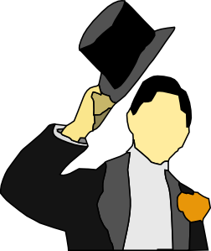
Restaurant etiquette, table and greeting manners

Slide 2
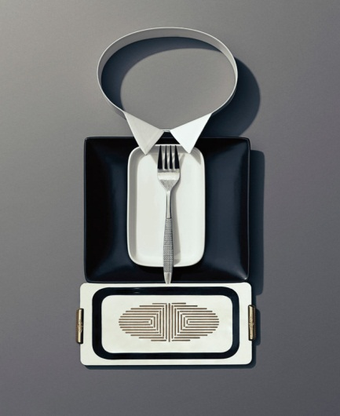
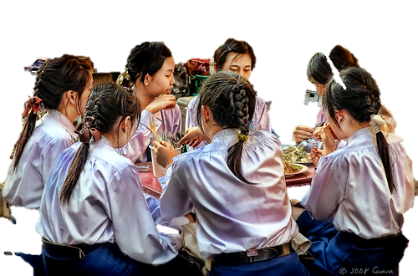
This lesson is maybe not about your dinner rules. We think you know the dinner rules of your culture very well.

Slide 3
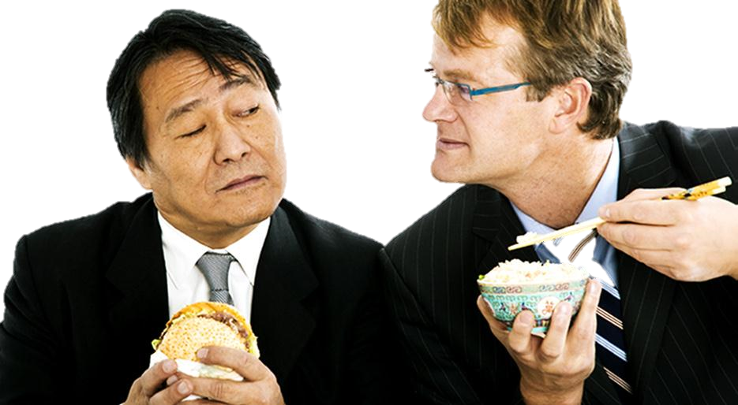
This lesson is more about the customs in a Western restaurant. This is useful to know when you eat somewhere abroad.
Knowing the etiquette makes you feel comfortable in a restaurant

Slide 4
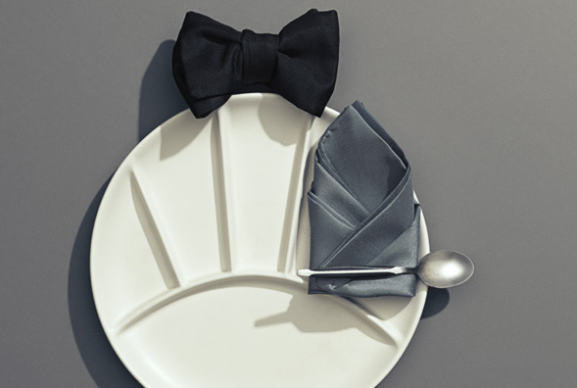
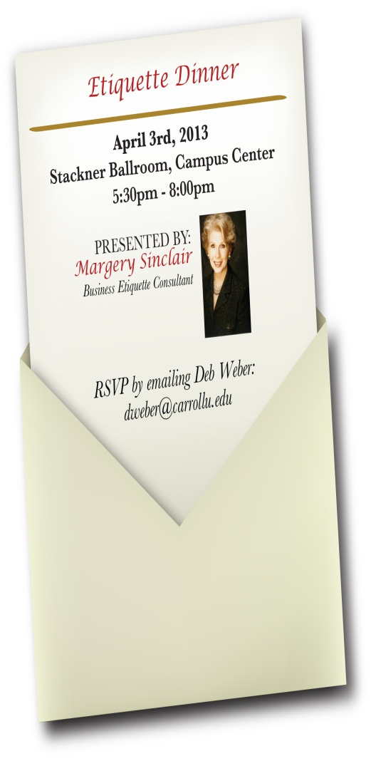
Etiquette Rules

Slide 5
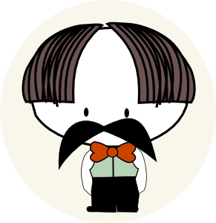
Meeting and greeting

Slide 6
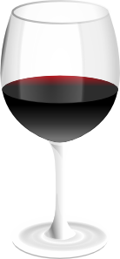
Some common etiquette rules
Be polite.
Men don’t wear a hat (cap) in a public building.
Do not use your cell phones in public buildings.
Excuse yourself when you leave the table before the end of the dinner.
Dress appropriately.

Slide 7
When greeting a guest..
Always be polite and sincere
Choose your words carefully.
Use the guest’s name two times during the conversation.
Make eye contact and smile.
Do not speak too slow or too fast; speak
clearly.

Slide 8
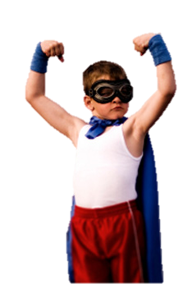
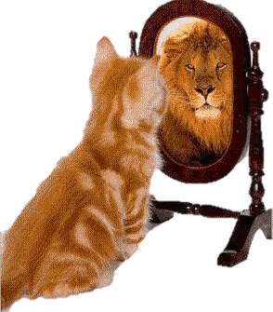
Body language
Signs of Confidence:
Uncross your legs.
Move to the end of your chair.
Lean toward the person.
Nod your head.
Gesture moderately.
Make eye contact.
Use a loud clear voice.
Vary your posture.

Slide 9
Body language
Signs of nervousness:
Cover your mouth.
Scratch your nose, head, ears.
Tug your clothes, jewelry, pen (etc.).
Look down, avoid eye contact.
Make unpleasant or inappropriate facial expressions.
Look away.

Slide 10
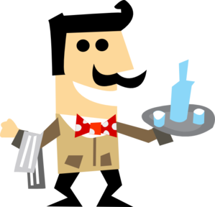
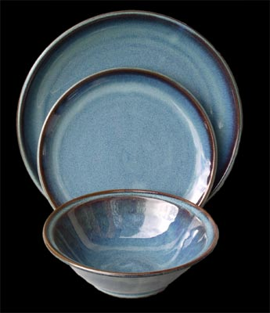
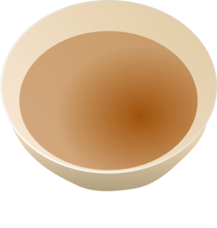
The Table Setting
for main dishes such as beef, lamb, fish and lasagna
dinner plate
for side dishes such as vegetables,
salad
and garlic bread
side plate
or
salad plate
soup
plate/
bowl

Slide 11
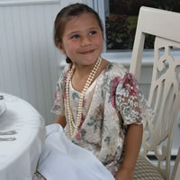
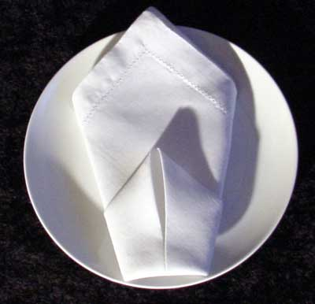
Once seated, the napkin….
you should only clean your lips and not make the napkin dirty
napkins belong in your lap
when finished with your meal, do not refold the napkin; lay it to the left of your plate
never flap your napkin
when you leave the table, rest the napkin on your chair and say: “Excuse me”
never use your napkin as a tissue

Slide 12
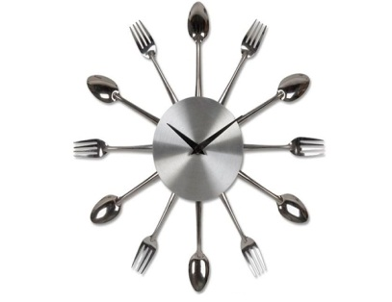
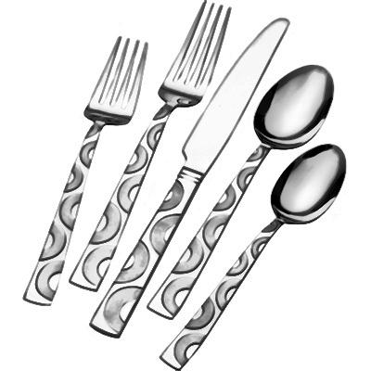
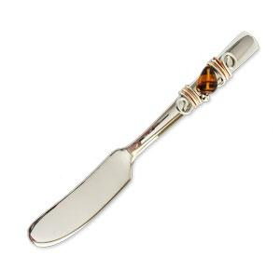
dessert spoon and fork
cutlery
(knives, forks and spoons, used for eating food)
salad fork
dinner spoon
soup
spoon
dinner fork
dinner
knife
butter
knife, small,
not sharp

Slide 13
The use of knives, forks and spoons
In most restaurants you will find one knife and one fork on the table
If there are more than one, use the one on the outside first
when you hold the knife or fork, you should relax your fingers
never let the knife, fork or spoon touch the table after you started eating
when you take a break from eating, you simply put your knife and fork on the plate
When you finished eating, put your knife and fork together pointing to the left.

Slide 14
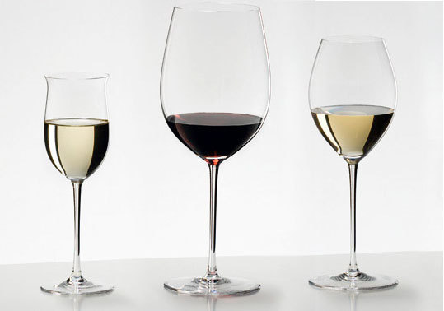
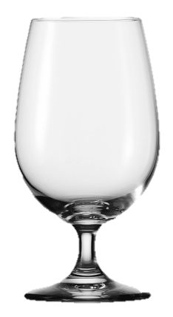
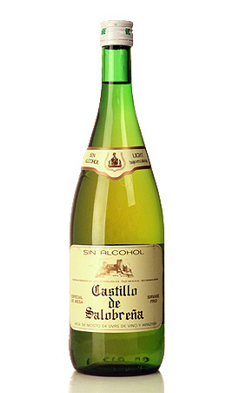
red wine glass.
(the biggest)
Champaign glass
(narrow)
dinner water glass
Dinner glasses
White wine glass
(same form as the red wine glass but smaller)

Slide 15
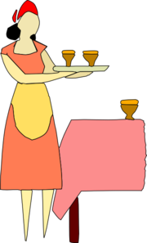
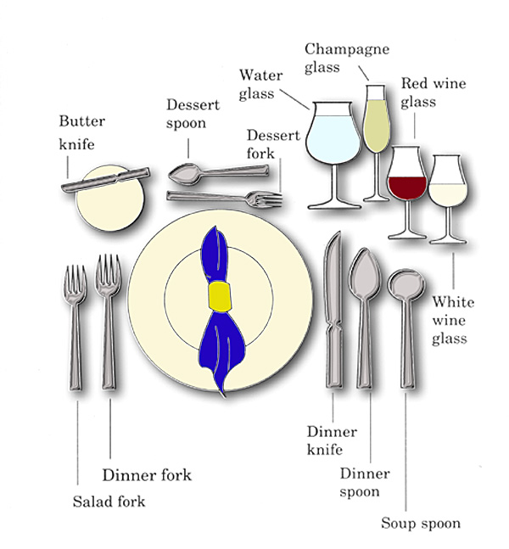
Table setting

Slide 16
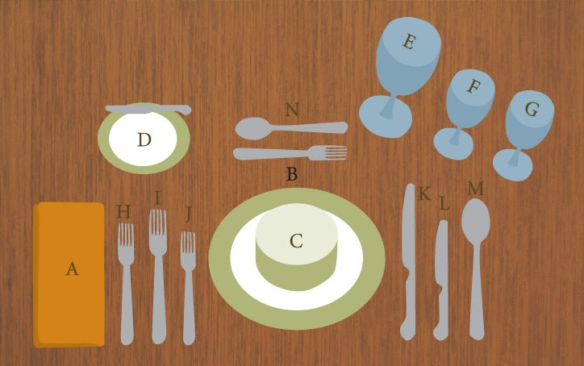
E:
red wine glass
A: napkin
B: dinner plate
D.
bread plate with
butter
knife
F:
white wine glass
N
dessert fork and dessert spoon
H
dinner fork
M:
dinner
spoon
G:
water glass
L:
salad knife
K:
dinner knife
C:
soup bowl
J:
salad fork

Slide 17
E:
red wine glass
A: napkin
B: dinner plate
D.
bread plate with
butter
knife
F:
white wine glass
N
dessert fork and dessert spoon
H
dinner fork
M:
dinner
spoon
G:
water glass
L:
salad knife
K:
dinner knife
C:
soup bowl
J:
salad fork

Slide 18
E:
A:
B:
D.
F:
N
H
M:
G:
L:
K:
C:
J:

Slide 19
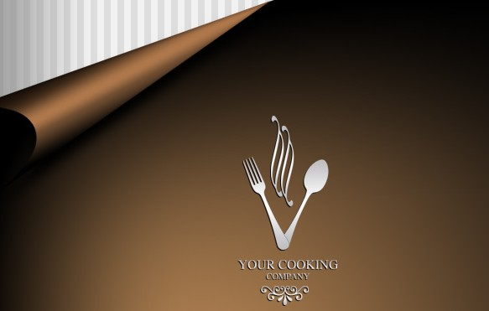
Menu
Soup: tomato soup
Pasta: Italian food like spaghetti and lasagna
fish
main meat dish
appetizer: small amount of food eaten before
a meal
roast meat prepared in a oven or over a fire like duck.
vegetables
salads
cheese and fruits
beverages: drinks

Slide 20
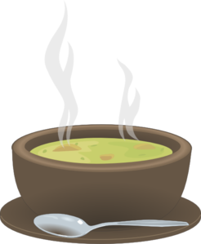
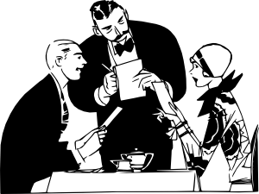
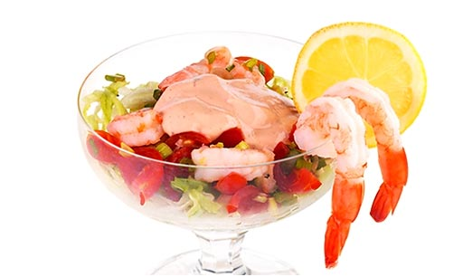
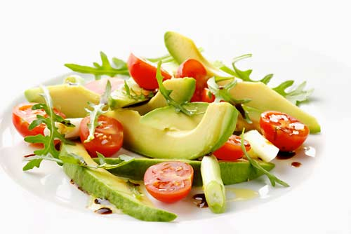
tomato soup,
mushroom soup,
chicken soup.
Appetizer
(a small amount of food eaten before a meal)
prawn
cocktail
avocado
cocktail

Slide 21
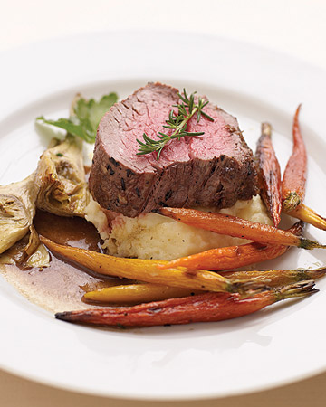
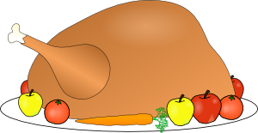
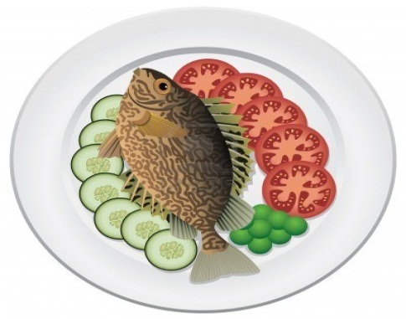
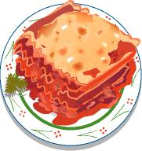
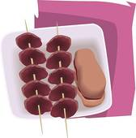
beef
chicken
fish
main course
lasagna
lamb

Slide 22
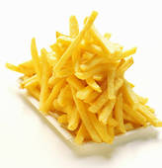
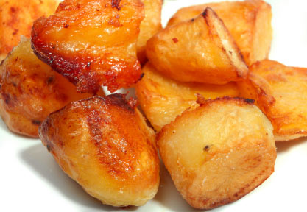
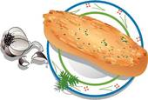
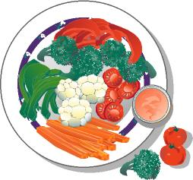
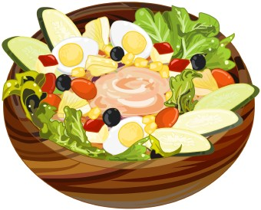
roast potatoes
French fries (chips)
Side dishes
salad
vegetables
garlic bread

Slide 23
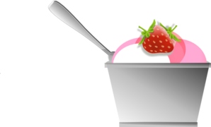
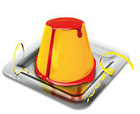
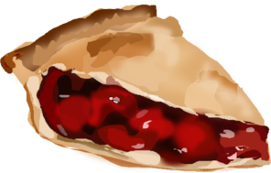
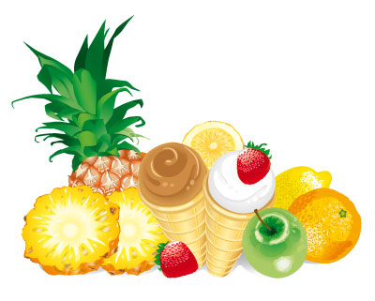
caramel pudding
ice cream
chocolate cake
cherries
pie
desserts
fruits

