Slide 1
Directions and City Orientation
RAINBOW OF EDUCATION

Slide 2
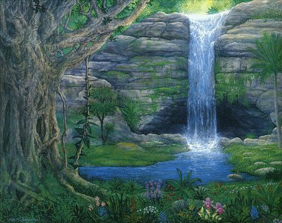
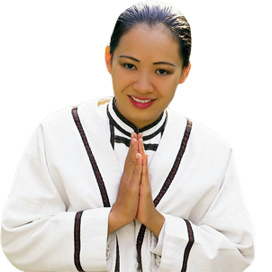
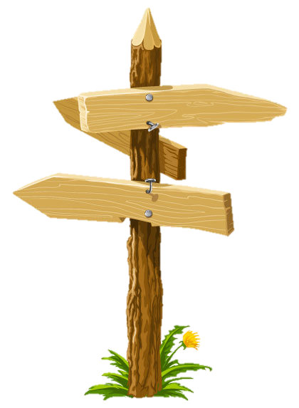
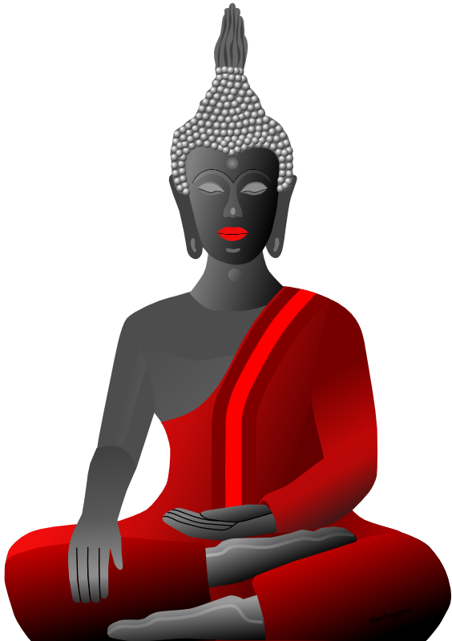
Welcome to
Chiang Mai
Doi Suthep
Chiang Mai Zoo

Slide 3
moving or not moving
The ball is rolling (moving)
The ball is on the ground.
Not moving / stationary

Slide 4
around

Slide 5
over

Slide 6
on

Slide 7
under

Slide 8
in

Slide 9
next to

Slide 10
past
Thailand

Slide 11
next to or past

Slide 12
behind
Thailand

Slide 13
in front of

Slide 14
over

Slide 15
between

Slide 16
Now, let’s exercise !

Slide 17
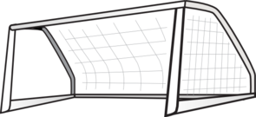
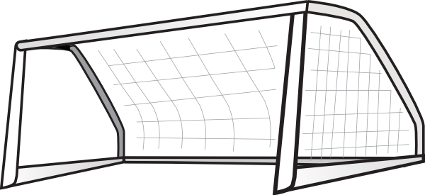
The ball is in the goal
Where is the ball?

Slide 18
The ball is in front of the goal
Where is the ball?

Slide 19
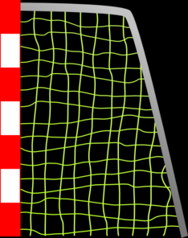
The ball is behind the goal.
Where is the ball?

Slide 20
The ball is going past the goal.
Where is the ball?

Slide 21
The ball is going over the goal
Where is the ball?

Slide 22
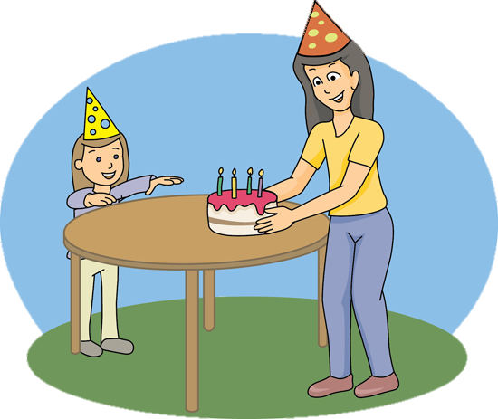
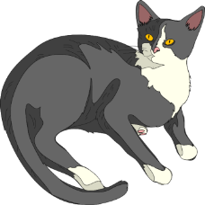
Where is the cat?

Slide 23
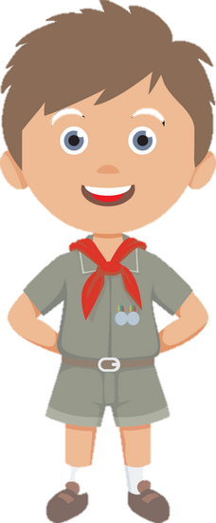
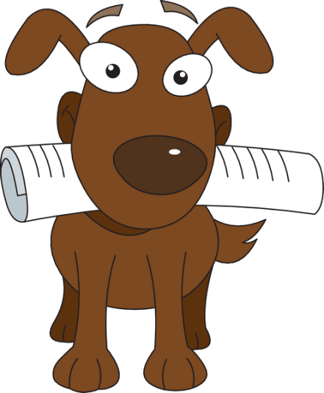
Where is the dog?

Slide 24
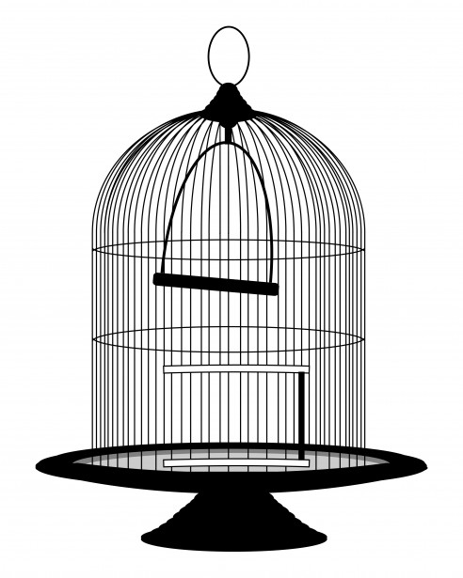
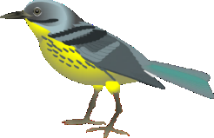
Where is the bird?
It’s on the cage.

Slide 25
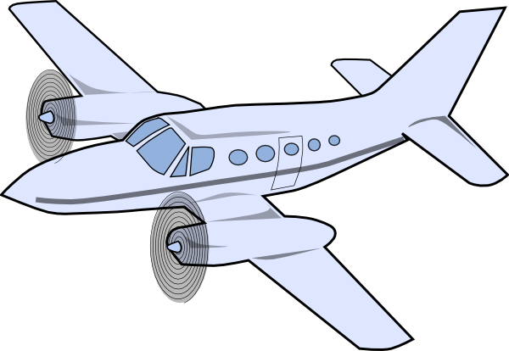
Where is the airplane?
It’s flying over the mountains.

Slide 26
Where is the ball?
It’s going through the basket.

Slide 27
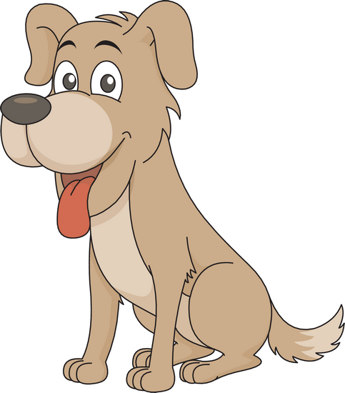
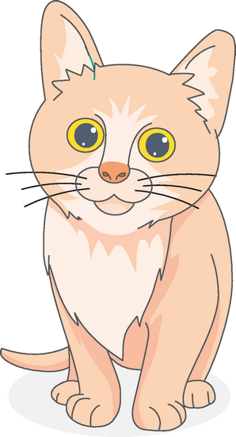
Where is the kitten?

Slide 28
Where is the strawberry?

Slide 29
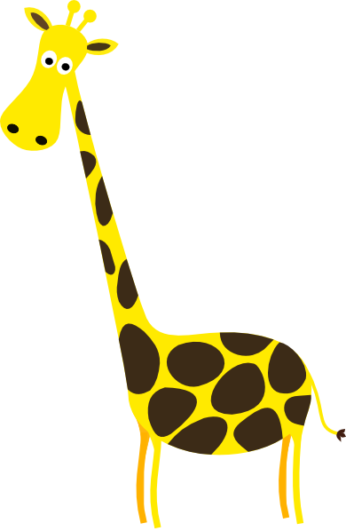
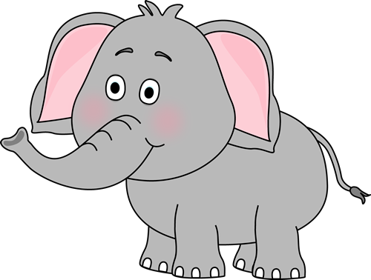
Where is the giraffe?

Slide 30
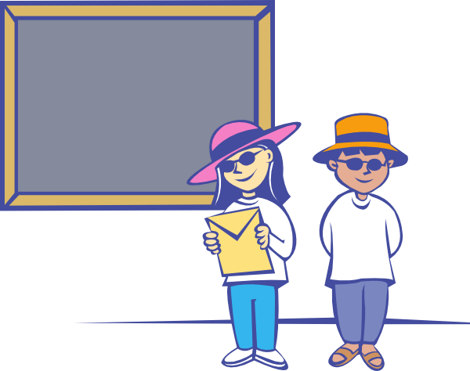
They are in front of the blackboard.
Where are the students?

Slide 31
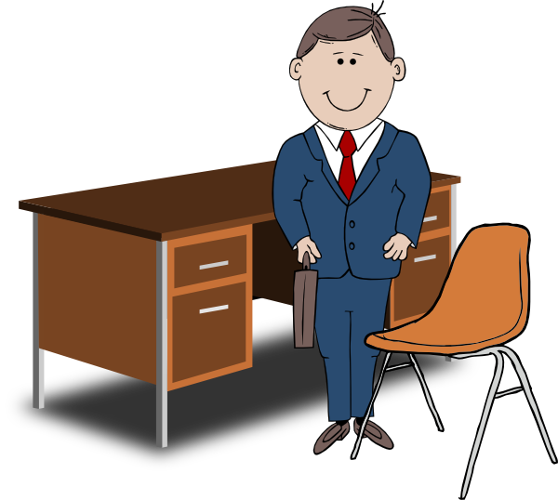
Where is the teacher?

Slide 32
Where is the owl?
It’s on the book.

Slide 33
It’s on the head.
Where is the hat?

Slide 34
It’s on the apple.
Where is the fly?

Slide 35
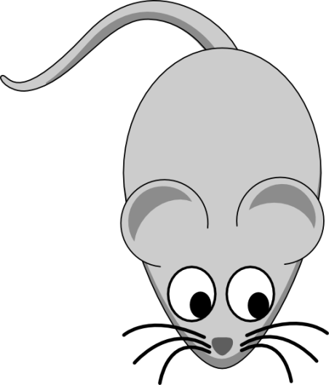
Where is the cat?
It’s opposite
the mouse.

Slide 36
Where is the owl?
It’s under
the umbrella.

Slide 37
Where is the squirrel?
It’s behind the box.

Slide 38
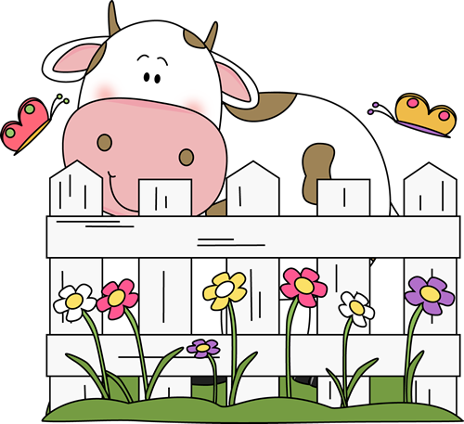
Where is the cow?
It’s behind the fence.

Slide 39
Where is the sun?
It’s behind the cloud.

Slide 40
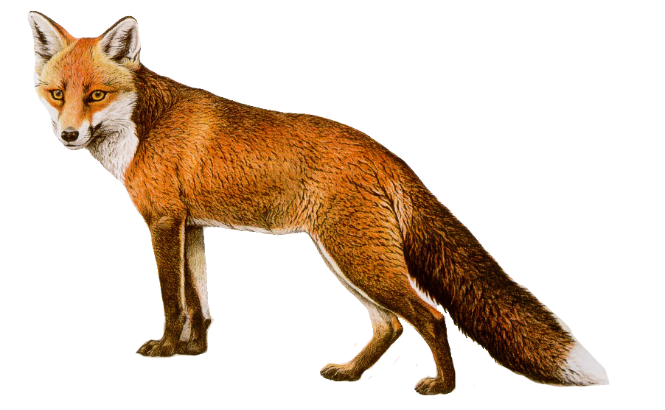
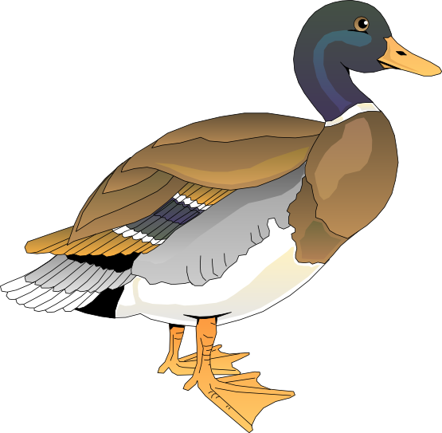
Where is the fox?
It’s opposite the duck.

Slide 41
Where is the owl?
It’s next to the mouse.

Slide 42
Where is the bird?
It’s flying over the water.

Slide 43
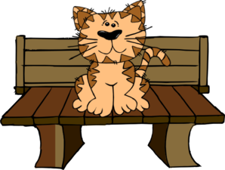
Where is the cat?
It’s on the garden seat.

Slide 44
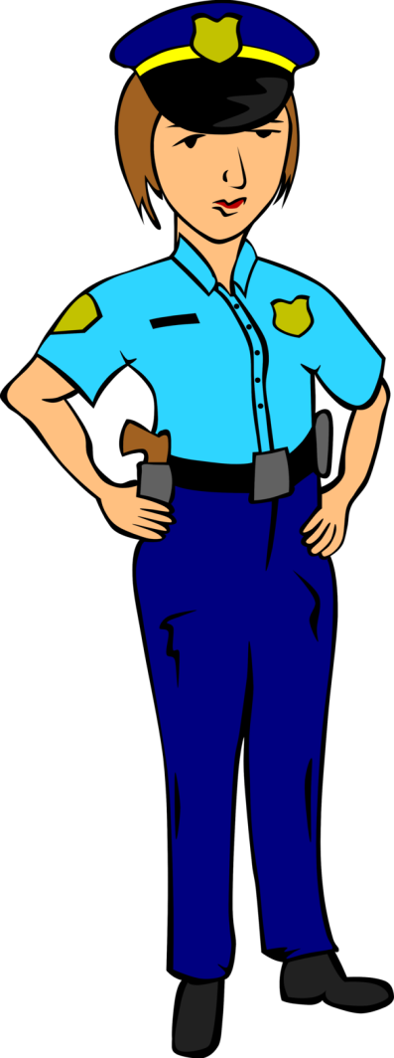
Where is the police woman?
She is next to the police car.

Slide 45
They are in the box.
Where are the books?

Slide 46
It’s in the cup.
Where is the frog?

Slide 47
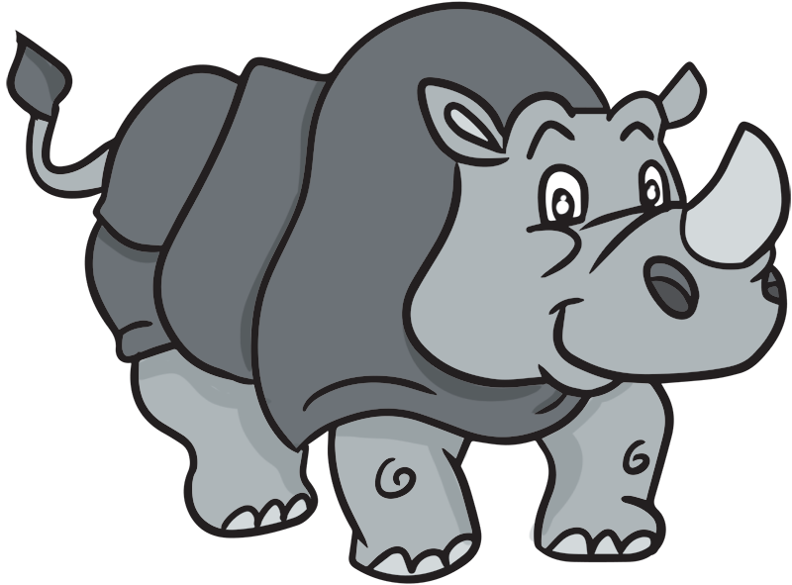
It’s behind the rhino.
Where is the palm tree?

Slide 48
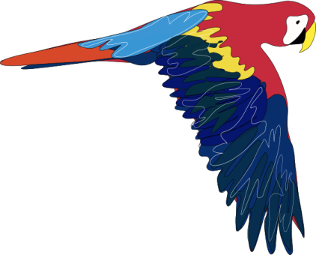
It’s flying over the houses.
Where is the parrot flying?

Slide 49
Where is the polar bear?
It’s on the ice.

Slide 50
Where is the shopping mall?
shopping mall
Bangkok Road
It’s on Bangkok Road.

Slide 51
Where is the post office?
Post Office
Amsterdam Road
It’s on Amsterdam Road.

Slide 52
Where is cinema?
It’s next to the restaurant.
cinema
restaurant

Slide 53
Manila Road
Where is the coffee shop?
It’s between the cinema and the bank.
cinema
coffee shop
bank

Slide 54
Manila Road
Where is the barber shop?
It’s on Bangkok Road.
barber
shop
B a n g k o k R o a d
It’s on the corner of Bangkok Road and
Manila Road.

Slide 55
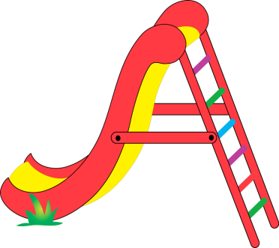
Manila Road
Museum
Where is the children’s playground?
It’s behind the museum.

Slide 56
buildings in a city

Slide 57
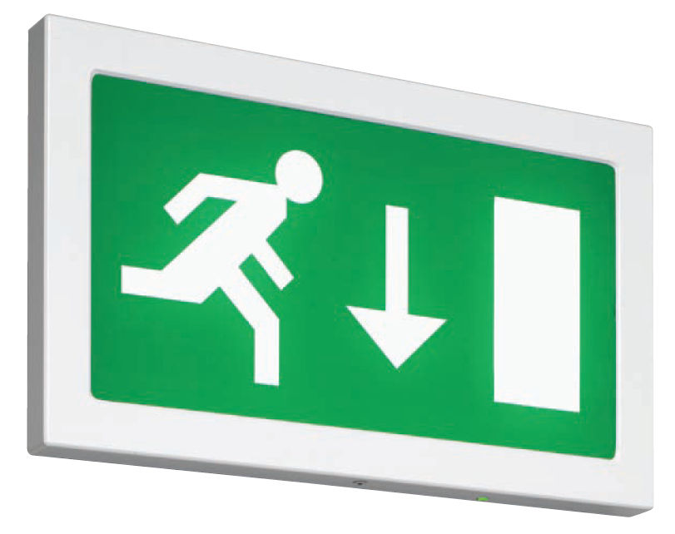
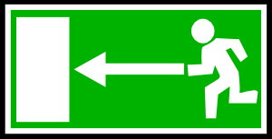
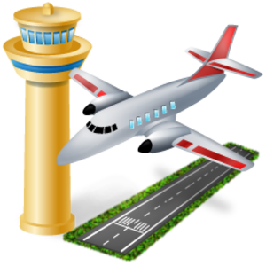
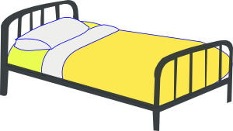
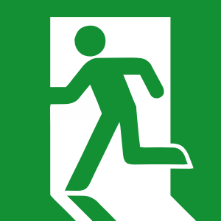
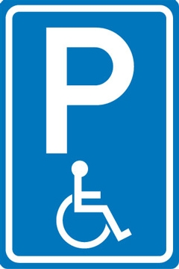
Airport

Slide 58
Post office

Slide 59
Hotel

Slide 60
Pharmacy

Slide 61
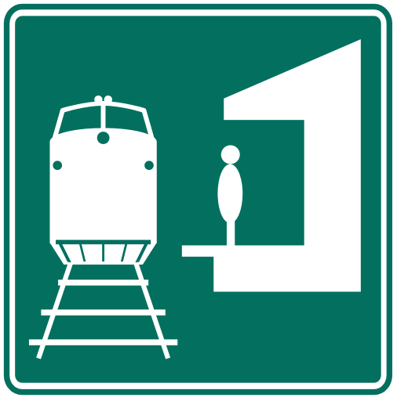
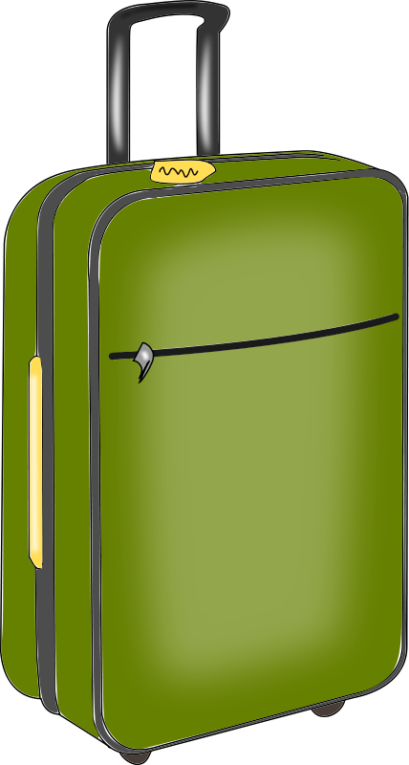
Railway station

Slide 62
Cinema

Slide 63
Restaurant

Slide 64
Temple

Slide 65
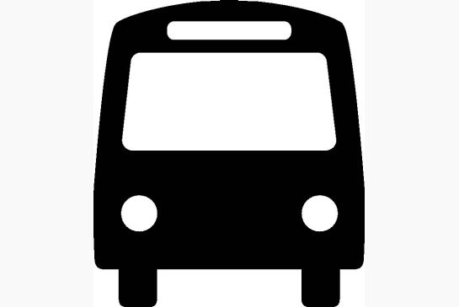
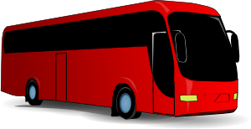
Bus stop

Slide 66
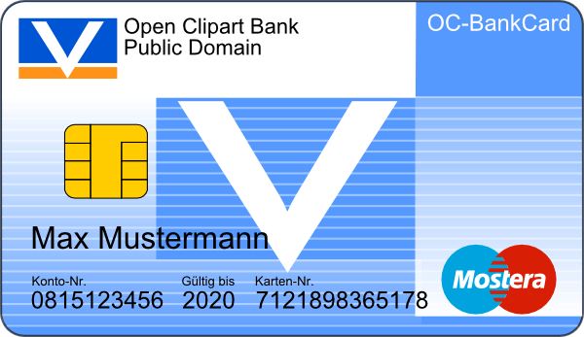
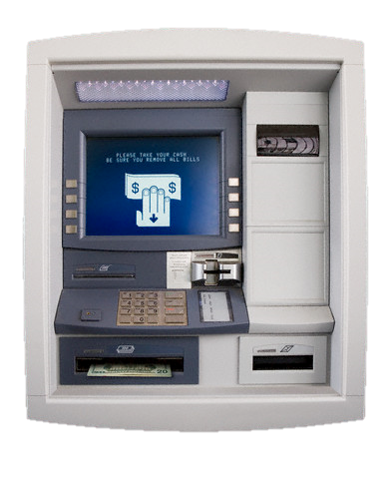
Bank and ATM machine

Slide 67
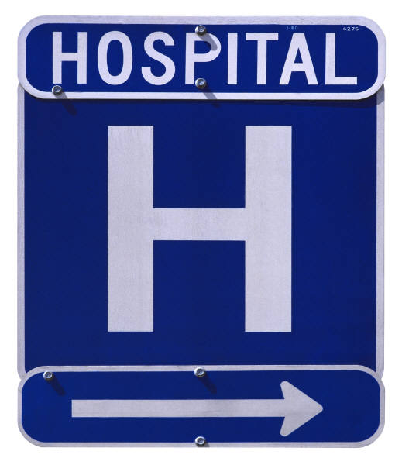
Theater
Music and Drama

Slide 68
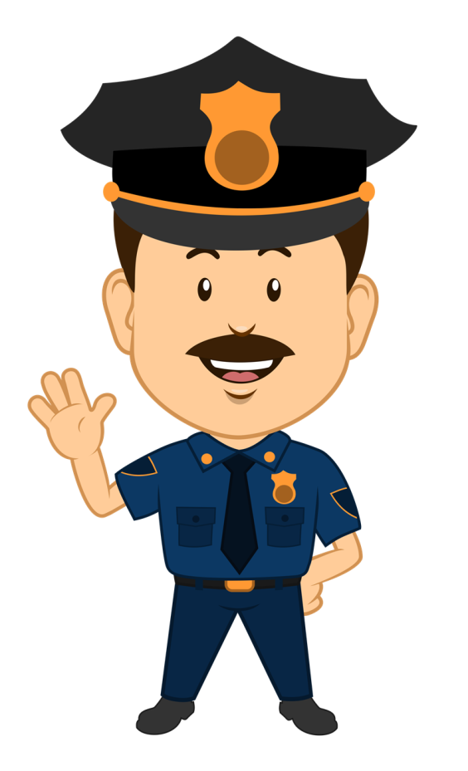
Police office

Slide 69
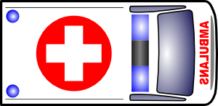
Hospital

Slide 70
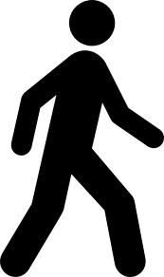
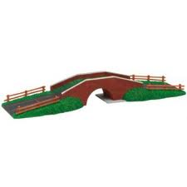
Cross the street
Cross
the intersection
Cross the bridge

Slide 71
Go straight

Slide 72
Turn right

Slide 73
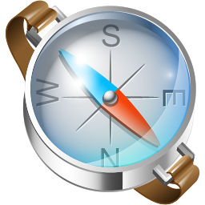
Turn left..
Turn left

Slide 74
third street on your left
fourth street on your right
second street on your left
third street on your right
second street on your right
first street on your left
First 1st
Second 2nd
Third 3rd
Fourth 4th
first street on your right

Slide 75
third street on your left
fourth street on your right
second street on your left
third street on your right
second street on your right
first street on your left
first street on your right

Slide 76
third street on your left
fourth street on your right
third street on your right
second street on your left
second street on your right
first street on your left
first street on your right

Slide 77
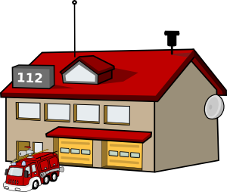
Question:
‘Excuse me.’
Could you tell me the way to the hotel please?’
school
fire station
airport
hotel
First (1)
building
on your left.
Second (2)
building
on your left.
Third (3)
building on
your left.
Fourth (4)
building on
your left.
1. ‘Go straight.’
2. ‘Take the second street on your right.’
3. ‘It’s next to the school.’
4. ‘It’s the first building on your left.’

Slide 78
Question:
‘Excuse me.’
Could you tell me the way to the fire station please?’
school
fire station
airport
hotel
First (1)
building
on your left.
Second (2)
building
on your left.
Third (3)
building on
your left.
Fourth (4)
building on
your left.
1. ‘Go straight.’
2. ‘Take the second street on your right.’
3. ‘It’s the third building on your left.’
3. ‘It’s between the airport and the school.’

Slide 79
school
fire station
hotel
airport
Question:
‘Excuse me.’
Could you tell me the way to the hotel please?’
1. ‘Go straight.’
2. ‘Take the second street on your left.’
3. ‘It’s the third building on your right’

Slide 80
Market Street
Question:
‘Excuse me.’
Could you tell me the way to 7 eleven please?’
1. ‘Go straight.’
5. ‘It’s opposite the school.’
2. ‘Take the third street on your left.’
3. ‘It’s the second building on your right.’
4. ‘It’s between the hotel and the temple.’
.

Slide 81
Suthep Road
Suthep Road
Question:
Excuse me.
Could you tell me the way to the Kasikorn bank please?
Answer:
Go straight,
Take the second street on your right,
Cross the intersection.
It’s the second building on your left.
It’s next to the barber shop.
It’s opposite Big C.
It’s at the corner of Suthep Road and King Rama the Second Road.
King Rama the Second
You are here.

Slide 82
Suthep Road
Suthep Road
Question:
Excuse me.
Could you tell me the way to the ATM machine please?
Answer:
Go straight,
Take the second street on your right,
Turn right on the intersection.
Turn left on the next intersection.
Turn right on the junction.
It’s the 2nd building on your left
It’s opposite the bus station.
It’s between the post office and the guesthouse.
King Rama the Second
You are here.

Slide 83
Huay Kaew Road
Market Street
Suthep Road
Go straight,
Take the second street on your right,
Then take the first street on your right.
Then take the first street on your left.
It’s the second building on your right.
It’s next to the school.
It’s opposite 7Eleven.
Canal Street
Soi 2
Thanon Rong Rian
School
Boulevard King Rama the Second
You are here.
Could you tell me the way to the fuel station please?

Slide 84
School
Longstreet
Huay
Kaew
R
oad
Thanon Rong rian
Suthep Road
Chiang Mai Road
Chiang Mai Zoo
Zoo Avenue

