Slide 1
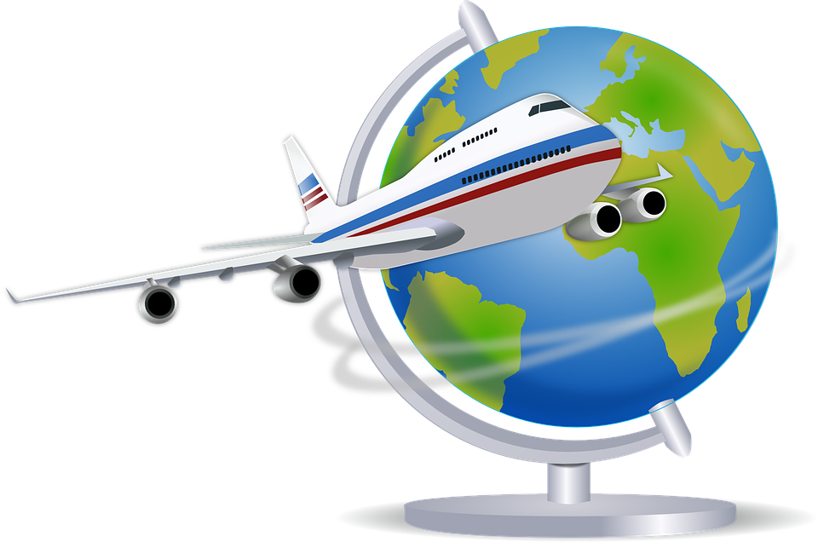
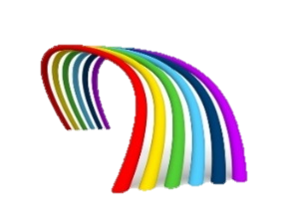
Travelling
RAINBOW OF EDUCATION

Slide 2
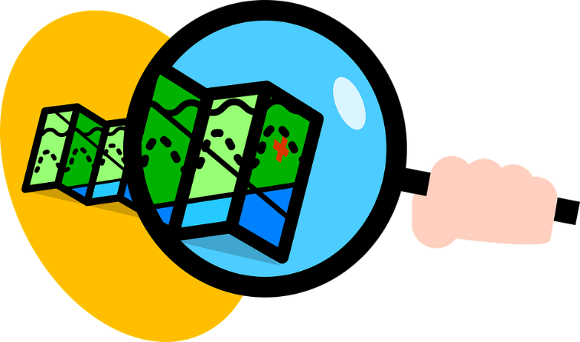
My favorite destinations. What are yours?

Slide 3
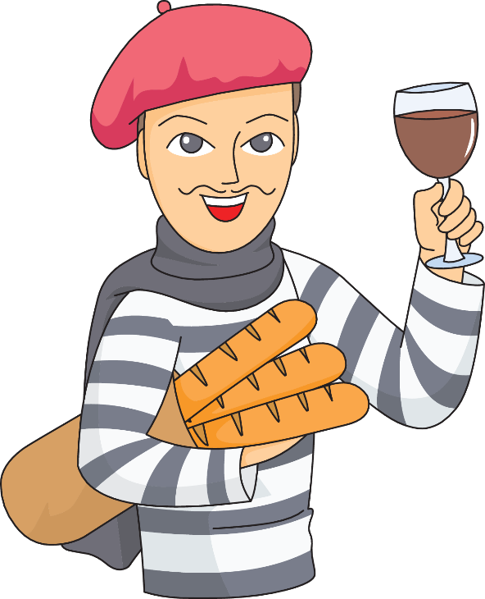
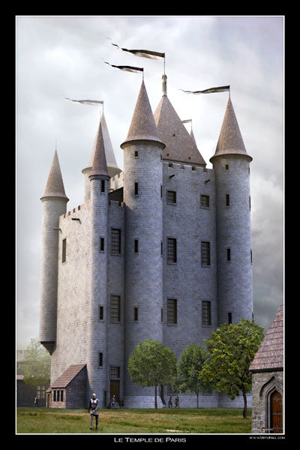
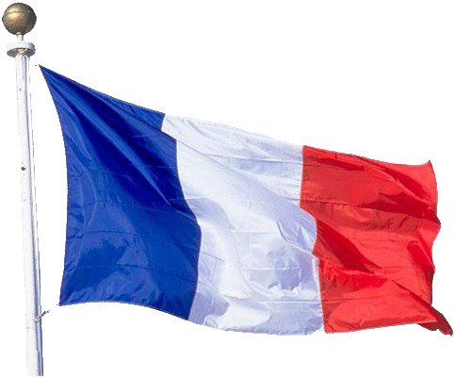
Castles of France..

Slide 4
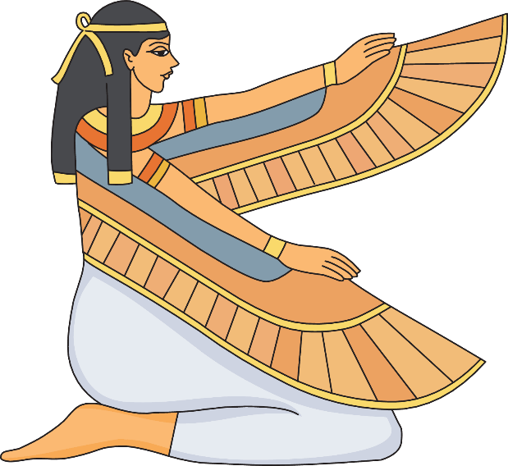
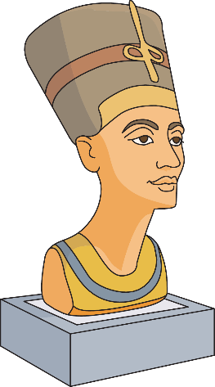
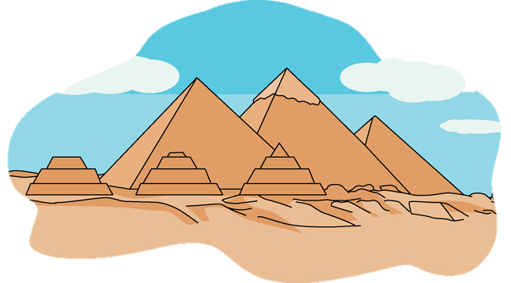
Egypt of the pharaohs

Slide 5
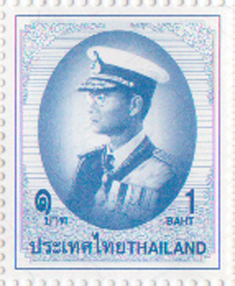
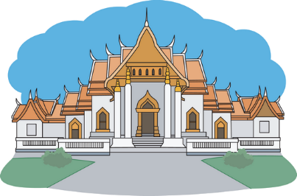
Thailand
But my most favorite..

Slide 6
What do you like to see
when you travel?
Perhaps something like this?

Slide 7
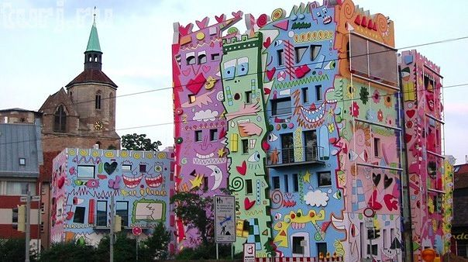

Slide 8
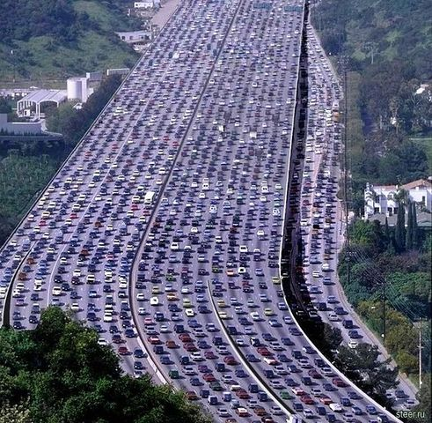

Slide 9
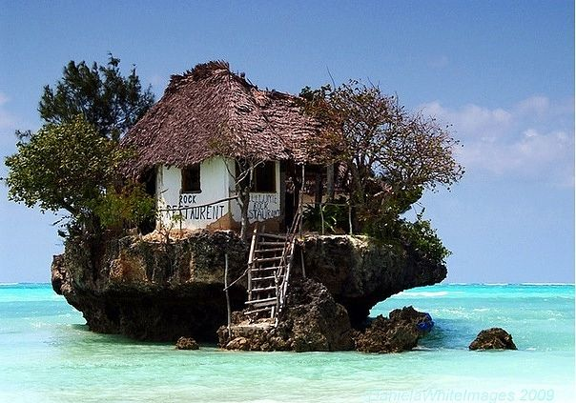

Slide 10
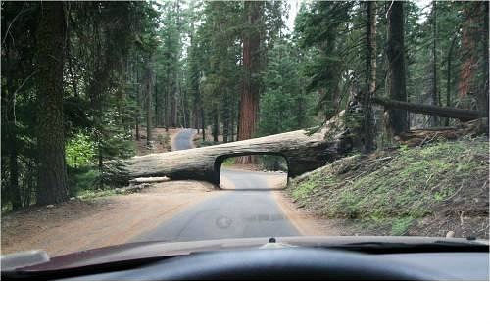

Slide 11
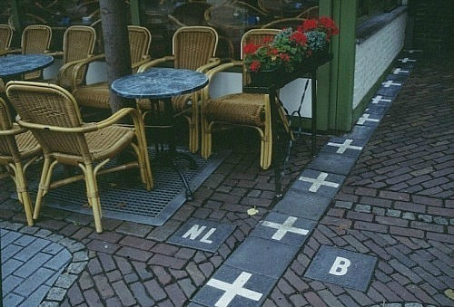

Slide 12
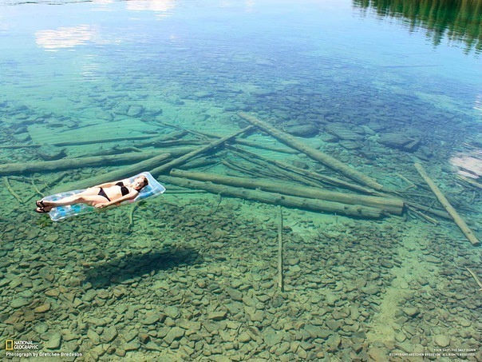

Slide 13
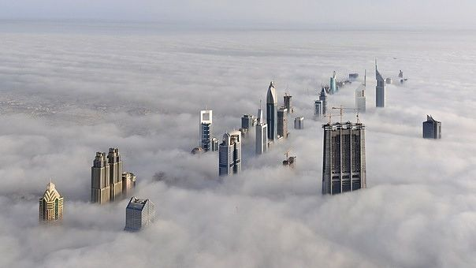

Slide 14
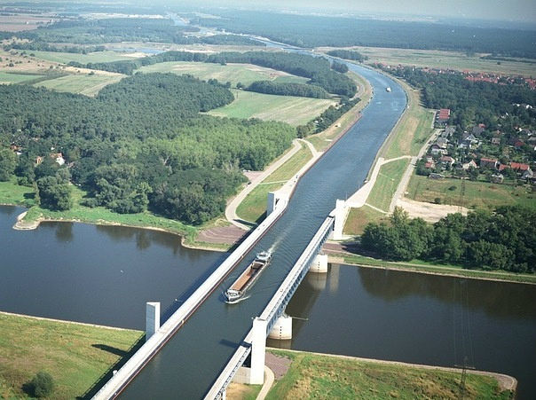

Slide 15
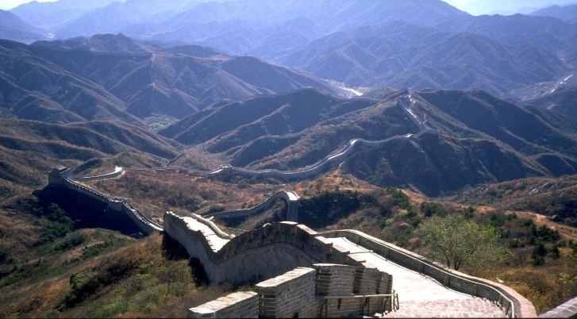
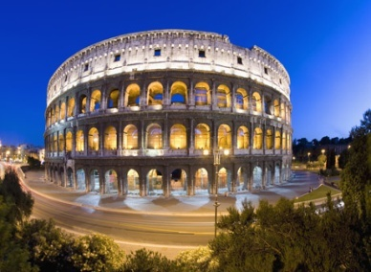
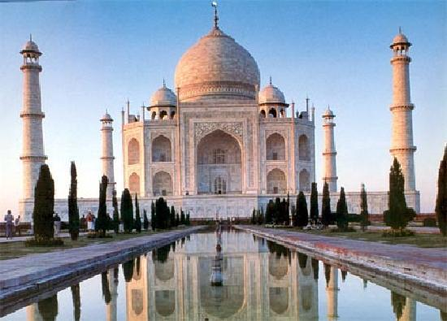
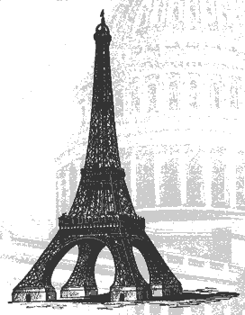
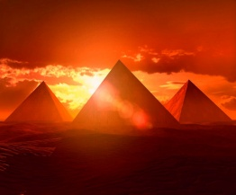
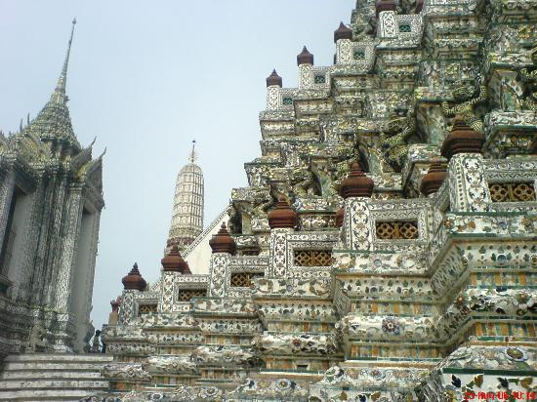
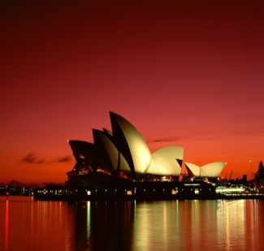
Famous destinations
Great Chinese Wall
Colosseum
Rome Italy
Leaning
Tower of Pisa,
Italy
Taj Mahal,
Agra, India
Eiffel Tower
Paris
Pyramids of
Egypt
Wat Phrae Kaew
Bangkok Thailand
Sydney Opera House
Australia

Slide 16
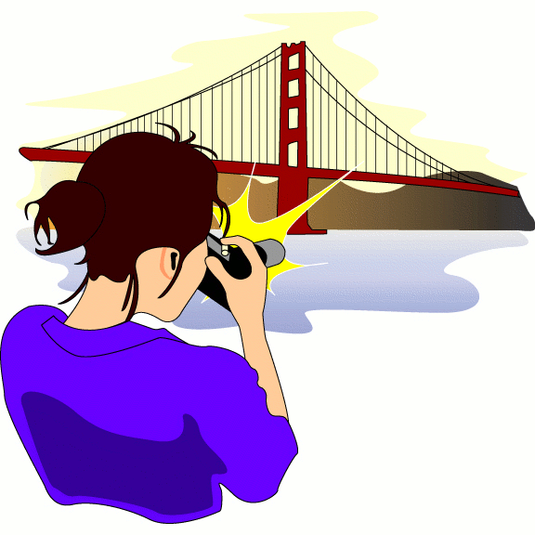
What is your favorite destination, and which activities are important for you ?
Geography (land and landscape)
Weather/temperature (swimming, skiing)
Religion (visiting temples, churches etc.)
Population (meeting local people)
Language and communication (practice
languages)
Tourist hotspots (seeing highlights)
Accommodation (nice hotel room etc.)
Getting around; touring (transport)
History (old sites)
Culture
Entertainment (fun)
Emergency contacts (doctor, hospital)

Slide 17
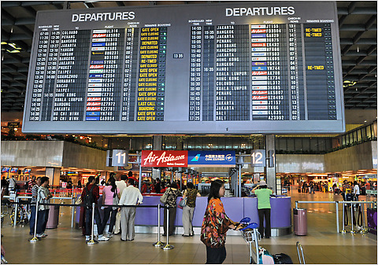
Routing at an airport

Slide 18
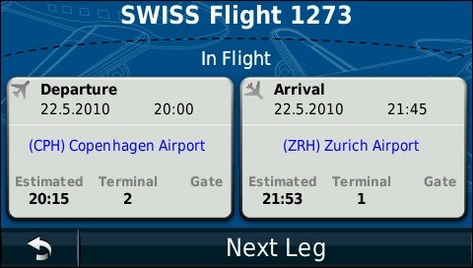
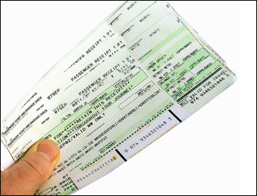
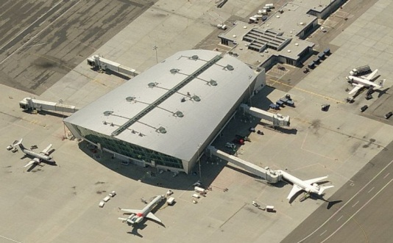
Take off
(leaving)
Landing
(arrive)
1273
B
C
Flight number
on your ticket
Gate: the door
to your airplane
Departure terminal:
(big hall)
Your departure airport: Copenhagen (CPH)
Your destination airport: Zurich (ZRH)

Slide 19
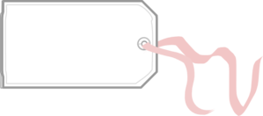
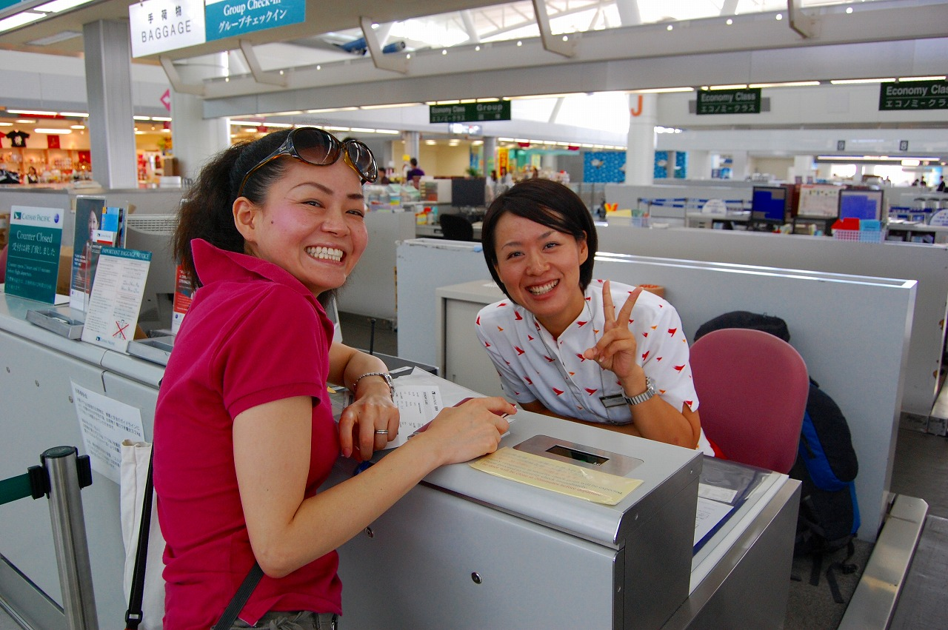
Check-in counter
It’s me
Check-in counter (desk):
Overweight baggage?
Check ticket.
Receive boarding pass with seat number.

Slide 20
Boarding pass: the passport to your airplane..
Gate number
Boarding
time.
Flight
number
chair number
Terminal
number
Departure
time
Terminal

Slide 21
concourse
Concourse:
The way to the gates.

Slide 22
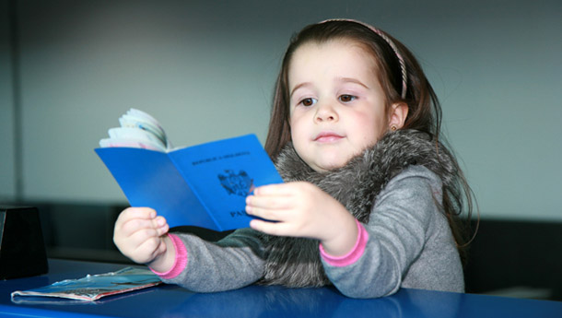
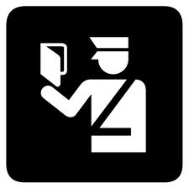
Passport control

Slide 23
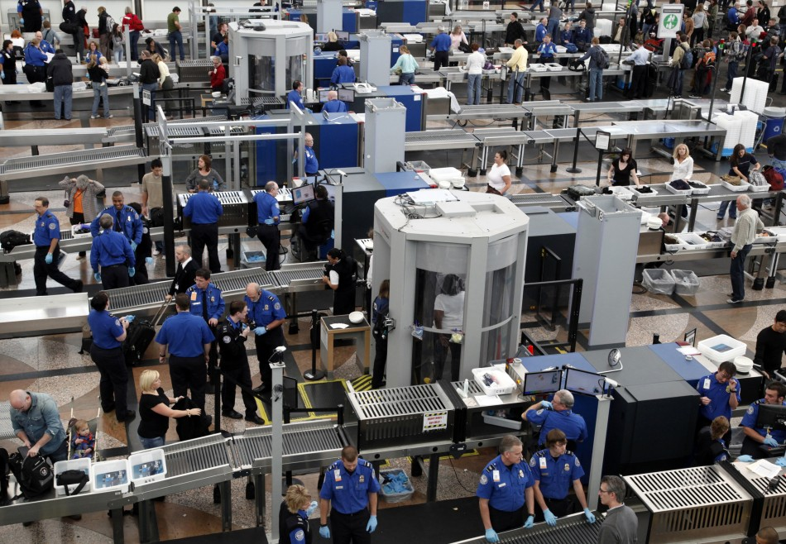
Security check

Slide 24
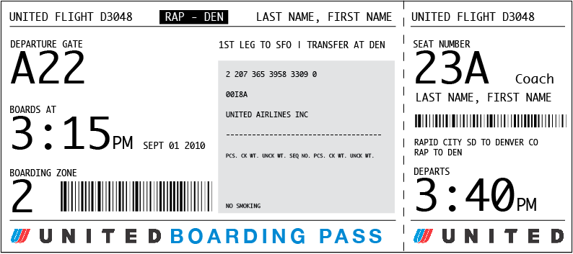
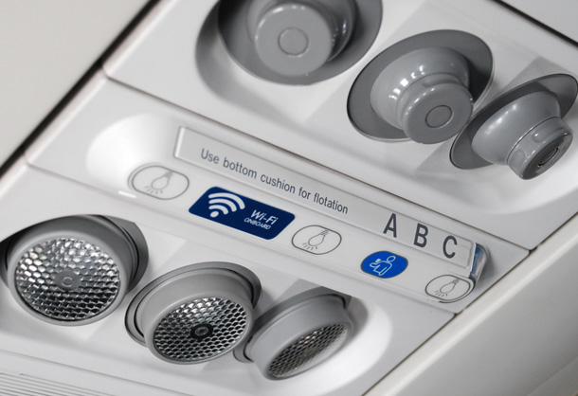
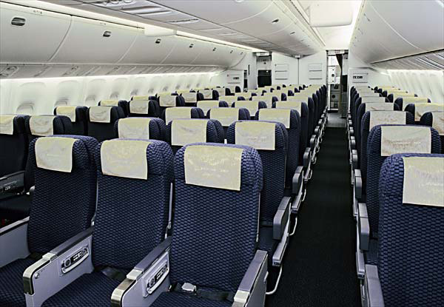
Where is my seat (airplane chair)?
Aisle seat.
Window seat

Slide 25
“This is your captain speaking..”

Slide 26
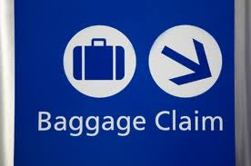
Baggage carousel

Slide 27
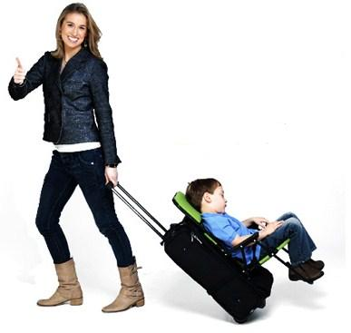
How to find the way to your airplane
Enter at the main entrance.
Look for your flight number (see ticket) in the departure terminal.
Go to the check-in counter.
Follow the signs , like B24; B is the terminal number and 24 is the gate number.
Pass the passport control.
Go shopping at the duty free shopping area.
Go to your terminal through the concourse.
Security check near the gate.
Go through the gate and the mobile tunnel to your airplane.

